Slide 1
Western Europe 500 – 1000 CE
AP World History Notes
Chapter 12

Slide 2
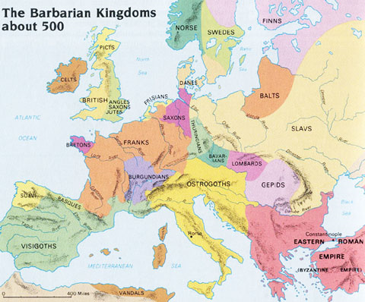
Political Life in Western Europe
Western Europe = now a series of regional kingdoms instead of one united empire
Many Germanic rulers were influenced by and embraced Roman culture
Many leaders wanted to recreate that unity that existed with the Roman Empire

Slide 3
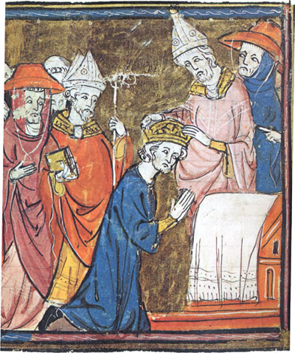
Charlemagne
Ruled the Carolingian Empire from 768 to 814 CE
Set up an imperial bureaucracy
Standardized weights and measures
Acted like an old imperial ruler
Christmas Day of 800 CE = he was crowned the “new Roman emperor” by the Pope

Slide 4
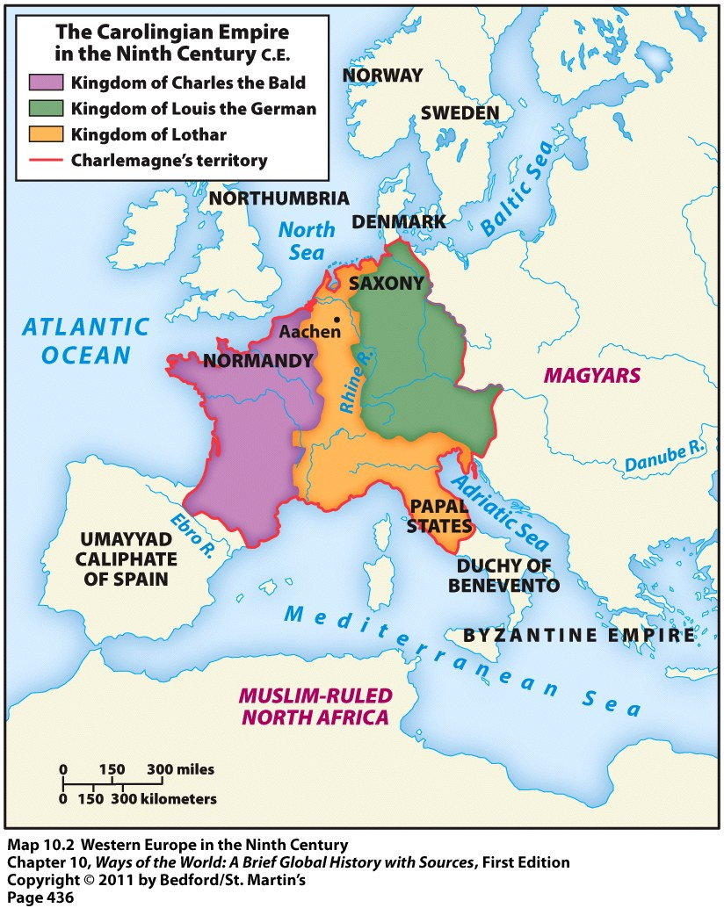
Charlemagne
His empire was divided among his sons after his death
Attempt at unity = unsuccessful

Slide 5
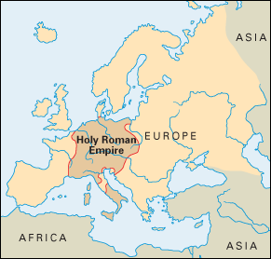
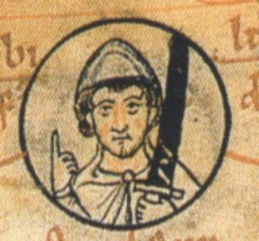
Otto I of Saxony
Created the Holy Roman Empire (mostly Germany and its surrounding areas)
Ruled from 936 to 973
Tried to regain unity in Western Europe just like Charlemagne
Also received title of emperor from the Pope
Unsuccessful ☹

Slide 6
Medieval Europe: Periodization
Early Middle Ages: 500 – 1000
High Middle Ages: 1000 – 1250
Late Middle Ages: 1250 - 1500

Slide 7
A New Political System
These new kingdoms = created a highly fragmented and decentralized society
Europe full of thousands of independent and isolated manors (estates)
Gave rise to a new system in Europe = feudalism = a political, economic, and social system based on loyalty and military service

Slide 8
A New Political System
Power = exercised by monarchs and elite landowning lords
Lesser lords and knights swore allegiance to greater lords and kings
Lesser lords = vassals = people who entered into a mutual obligation to a higher lord or monarch
Gave them: military protection and support
In return they got: land or fiefs
Fiefs = estates that came with serfs to work the land

Slide 9
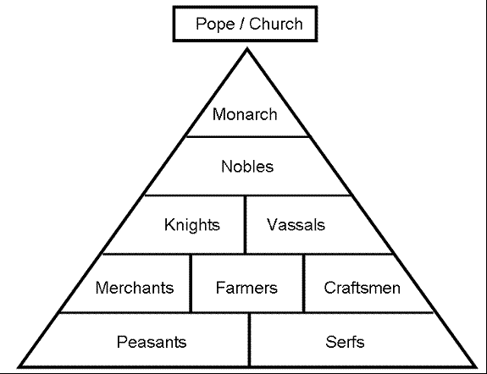
Feudalism

Slide 10
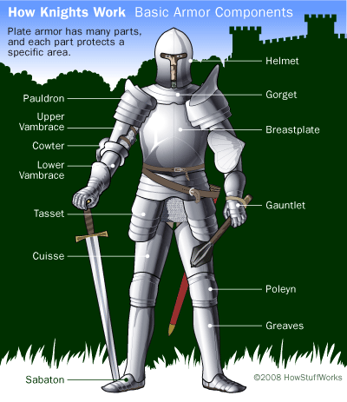
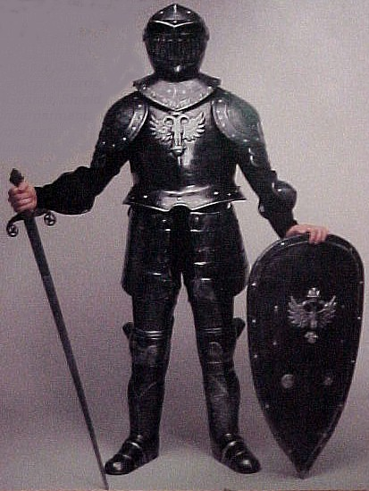
Medieval Knights

Slide 11
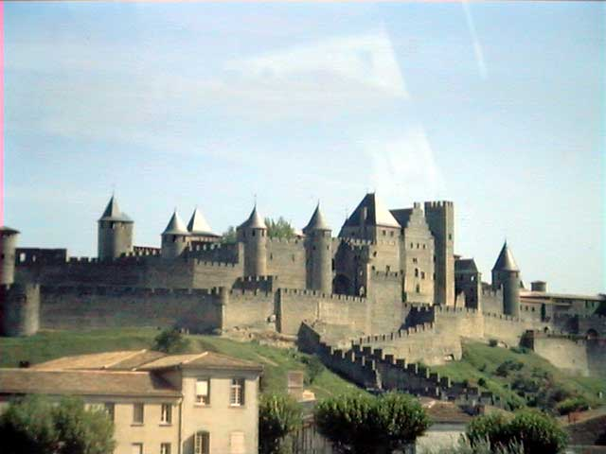
A Medieval Castle

Slide 12
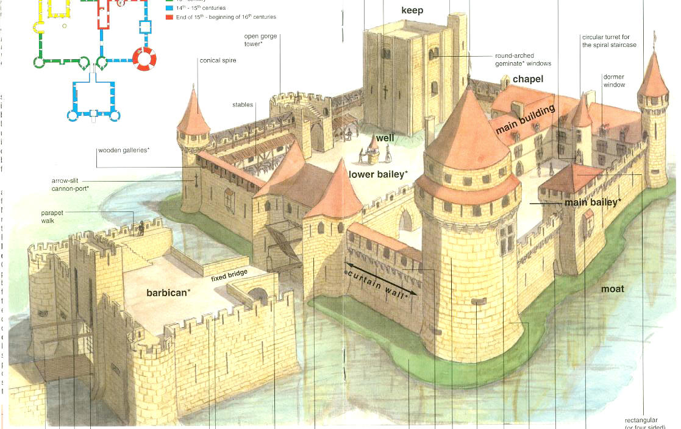
Parts of a Medieval Castle

Slide 13
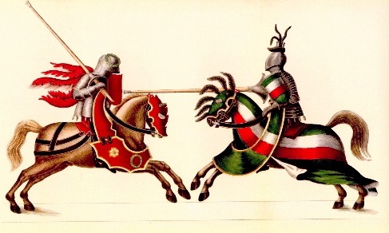
Life of the Nobility
Nobility consisted of lords, ladies, and knights
A lord had almost total authority over his fief
A lady had few, if any, rights
For entertainment, tournaments were held
Mock battles between knights

Slide 14
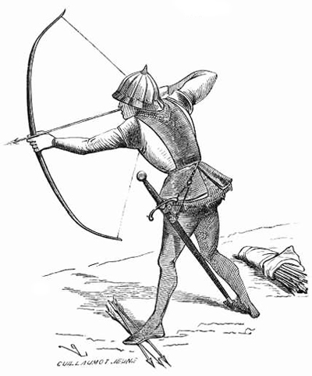
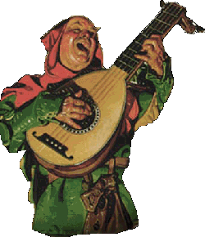
Life of the Nobility
Other entertainment = archery, big dinners, minstrels, and singers

Slide 15
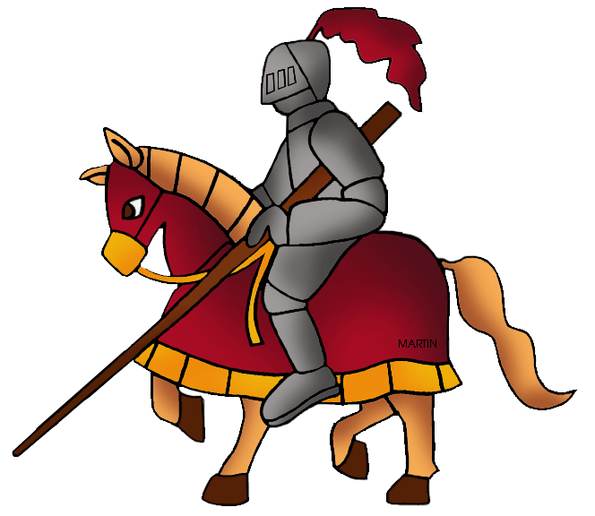
Becoming a Knight…
Boys became knights by:
Starting as a page (assistant) to the lord at age 7
At 15, he became a squire who assisted a knight
Once he proved himself in battle, he was knighted in a ceremony

Slide 16
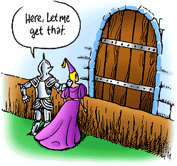
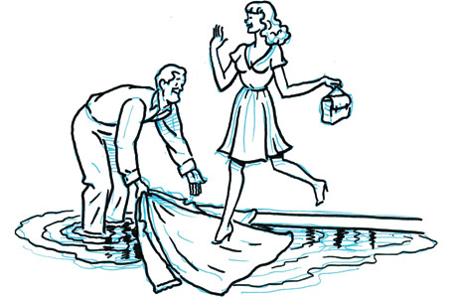
Becoming a Knight…
Knights’ behavior was governed by a code of chivalry
This became the basis for good manners in western society

Slide 17
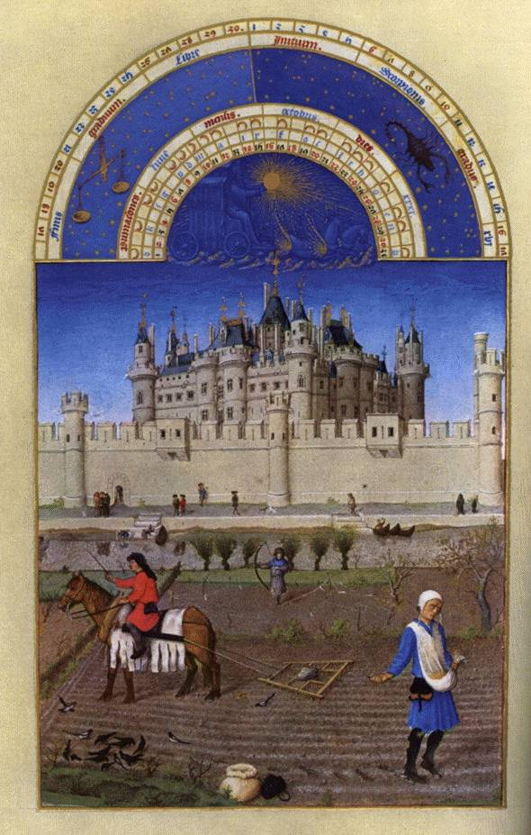
The Manorial System
Peasants lived on & worked the lord’s land
This agricultural economic system is known as manorialism
In return for the lord’s protection, the peasants provided services for the lord
Farming, herding, weapon making, etc.
Most peasants were serfs = people who couldn’t leave the lord’s manor without permission

Slide 18
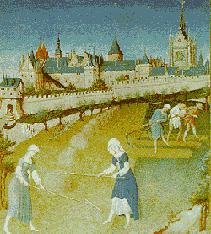
Serfs vs. Slaves
Serfs = tied to the land; not the personal property of a specific person
Slaves = belong to their master

Slide 19
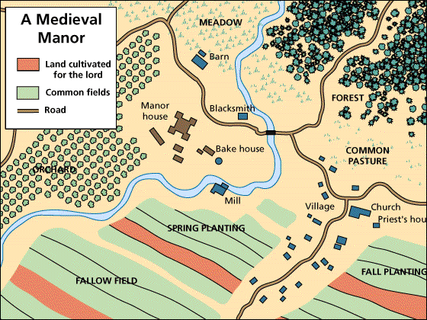
The Medieval Manor

Slide 20
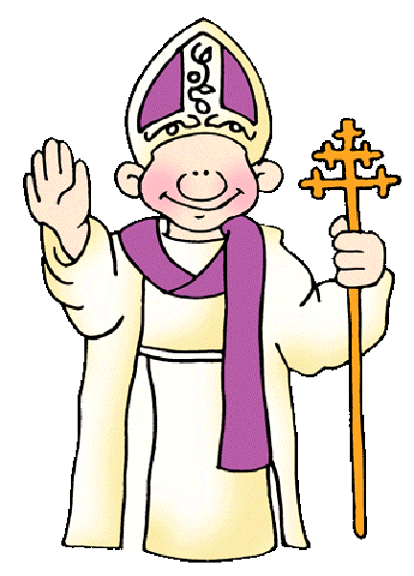
Christianity of Western Europe
Roman Catholicism
How did it spread throughout Western Europe?
Church leaders and missionaries used a “top-down” strategy
Converted people at the top (kings and higher lords) first → then they would persuade those below them to convert as well
Many kings & lords chose to convert because: they liked the Church’s connection to the “civilized” and “grand” Roman Empire

Slide 21
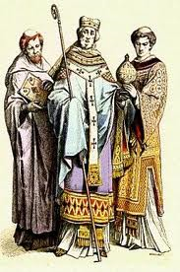
Christianity of Western Europe
Church authorities also had a lot of political power
They worked together with kings, nobles, and knights
Rulers gave the Church: protection and support of the religion
The Church gave the rulers: religious legitimacy for their power (“It is the will of the Creator…”
Sometimes they competed for power as well
A Church Leader

Slide 22
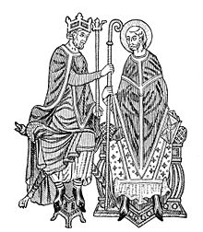
The Investiture Conflict
Conflict over: who should appoint bishops and the pope himself
The Church? Or kings and emperors?
Compromise = the Church can select its own officials and rulers retain an informal and symbolic role in the process

