Slide 1
Commerce & Culture 500-1500 CE Trans-Saharan Trade
AP World History – Chapter 9 Notes

Slide 2
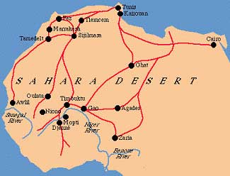
The Sand Roads
Trans-Saharan trade route
Linked North Africa and the Mediterranean world with West Africa

Slide 3
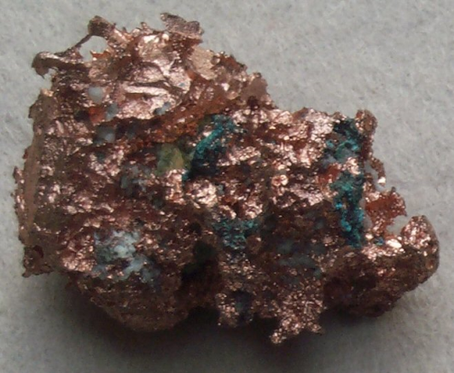
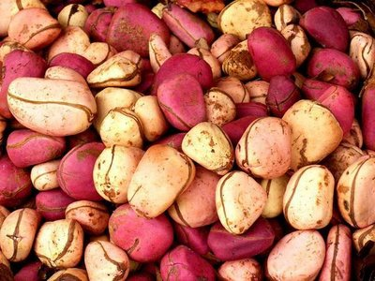
Trans-Saharan Trade
Like the Silk and Sea Roads → this trade begins as a result of environmental variation
What does each region have to offer?
North African coastal areas = cloth, glassware, weapons, books
Sahara region = copper and salt
Savanna grasslands = grain crops
Sub-Saharan forests = tree crops like yam and kola nuts

Slide 4
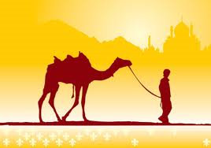
Trans-Saharan Trade
Made possible by the CAMEL!
1st traders = camel-owning people from desert oases
Major traders became = North African Muslim Arabs
What did they come to West Africa and sub-Saharan Africa for?
GOLD!, ivory, kola nuts, slaves
Gave in return: SALT!, horses, cloth, weapons, tools

Slide 5
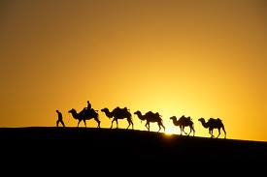
Caravans
As many as 5,000 camels
Hundreds of people
Travelling at night
Length of journey = about 70 days
15-20 miles walked per day

Slide 6
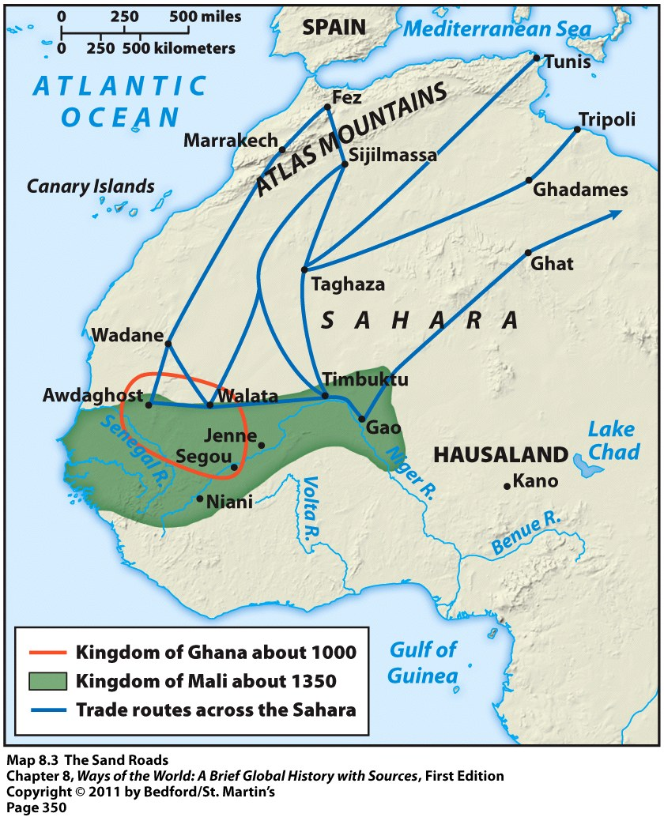
Construction of Empires
New wealth and resources from trans-Saharan trade allowed some regions to construct large empires or city-states
Between 500 and 1600 CE
Major empires = Mali, Ghana, and Songhai

Slide 7
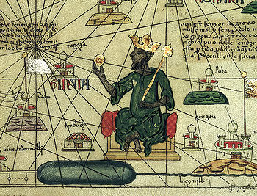
West African Empires
All monarchies
Drew upon wealth of trans-Saharan trade
Relied on slaves
Females used as = domestic servants and sex slaves
Males used as = state officials, craftsmen, miners, agricultural laborers

Slide 8
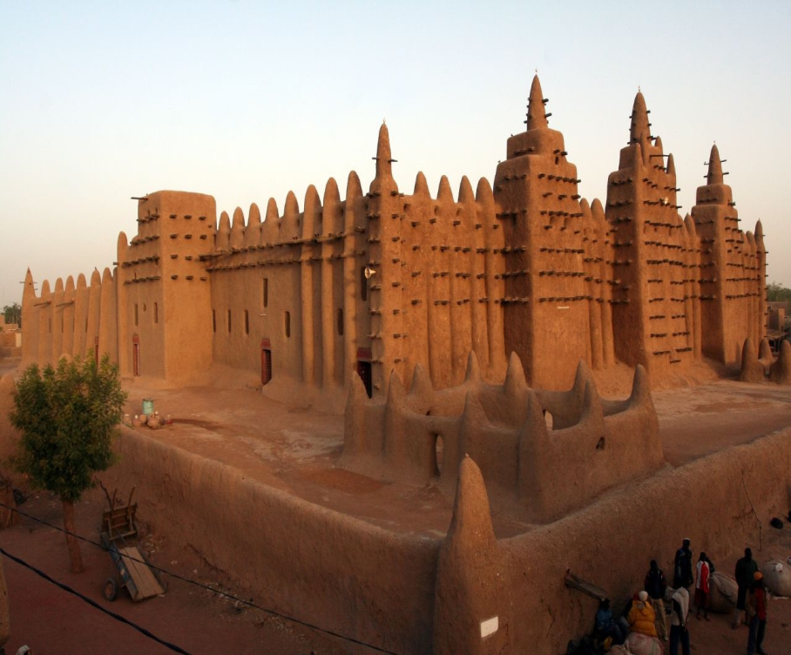
Cities Within the Kingdoms
Urban and commercial centers
Traders met and exchanged goods there
Centers of manufacturing
Items created: beads, iron tools, cotton textiles, etc.
Largely Islamic
Mosque in Timbuktu (in Mali)

