Slide 1
The Scientific Revolution
AP World History Notes
Chapter 15
Religion and Science (1450-1750)

Slide 2
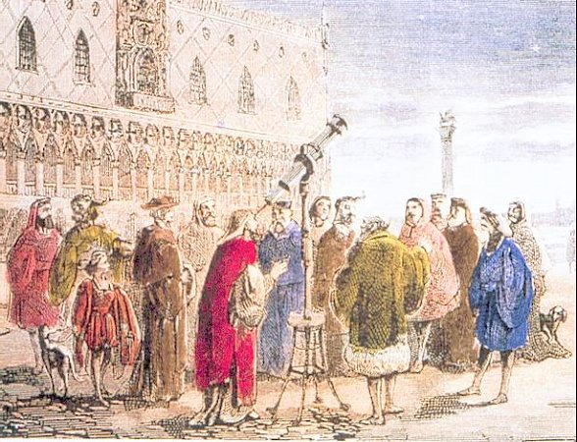
The Scientific Revolution
Intellectual and cultural transformation
Began in Europe
Mid-1500s to early 1700s
Knowledge acquired through: careful observations, controlled experiments, the formulation of general laws, and mathematical expressions
No more reliance on: the authority of the Bible, the Church, the speculations of ancient philosophers, or the received wisdom of cultural tradition

Slide 3
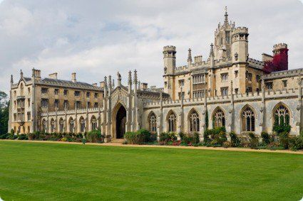
The Question of Origins: Why Europe?
12th and 13th centuries = Europeans developed a legal system that gave a measure of independence to a variety of institutions
Ex: the Church; towns and cities; workers’ guilds; professional organizations; universities
Independence for universities = scholars had the freedom to pursue their studies without interference from the Church or political authorities
Most of the major figures in the Scientific Revolution = trained in or affiliated with these universities
Cambridge University in England

Slide 4
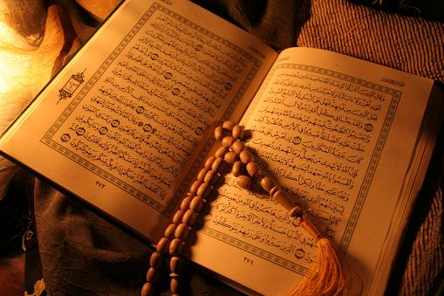
Why Not the Islamic World?
Focus in colleges/universities = Quranic studies and religious law
Science was studied outside the formal system of higher education
Religious scholars = viewed science and philosophy with suspicion
To them = Quran holds all the wisdom
Science might challenge the Quran
Science and philosophy lead to uncertainty and confusion

Slide 5
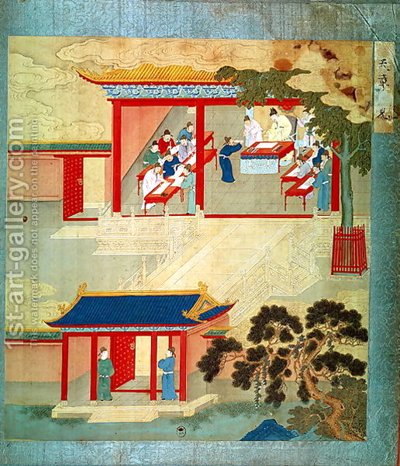
Why Not China?
Chinese education = focused on preparing males for the civil service examinations
Focused on classical Confucian texts
Chinese authorities = did not allow independent institutions of learning where scholars could pursue their studies freely

Slide 6
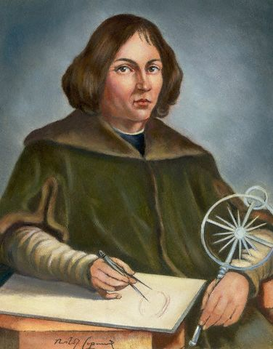
Nicolaus Copernicus
Polish astronomer
Started his career at University of Krakow in Poland in 1492
At the forefront of the Scientific Revolution
Started at a time when few people dared to question old beliefs and superstitions

Slide 7
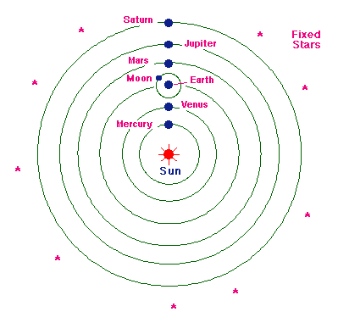
Nicolaus Copernicus
Believed the Earth was round & that it rotated around the sun
Said the sun, not the Earth, was the center of the universe
Challenged the idea that the Earth was unique and at the center of God’s attention

Slide 8
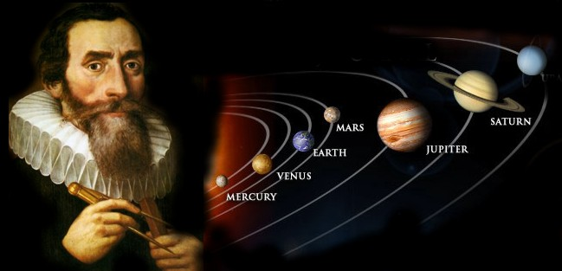
Johannes Kepler
German astronomer & mathematician
Protestant
Used math formulas to show that the planets revolved around the sun
Planets moved in ellipses = ovals
Planets don’t always travel at the same speed - move faster as they approach the sun

Slide 9
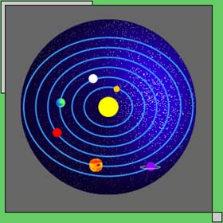
Johannes Kepler

Slide 10
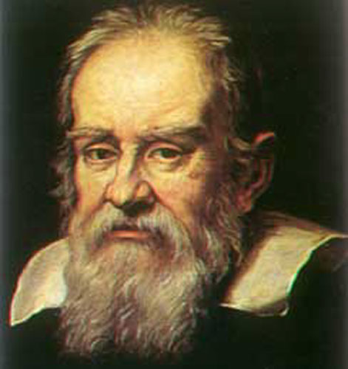
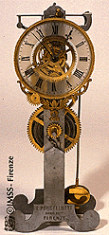
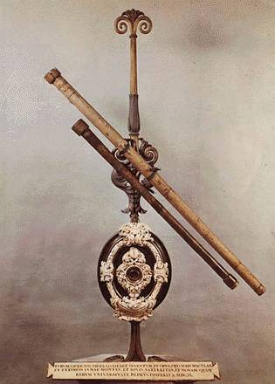
Galileo Galilei
Italian mathematician
Improved the telescope to make it more powerful
Observed: sunspots, mountains on the moon, Jupiter’s moons
Created the pendulum clock
1636 = published ideas on physics, astronomy, etc.
Book banned by the Catholic Church

Slide 11
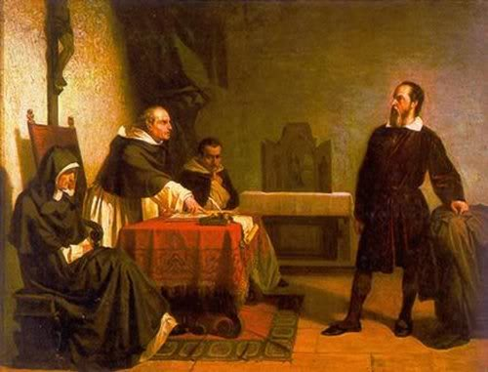
Galileo Galilei
Faced heated opposition by the Catholic Church
Placed under house arrest for 50 years
Where he made most of his discoveries & achievements

Slide 12
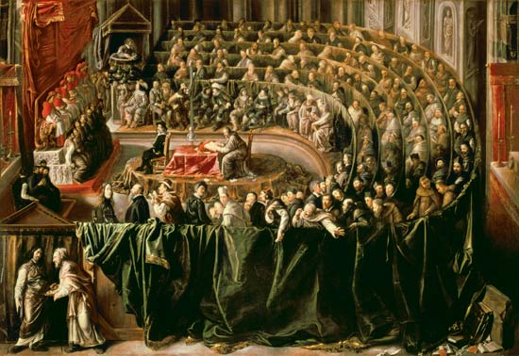
Trial of Galileo

Slide 13
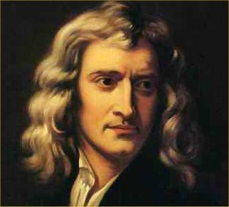
Sir Isaac Newton
British scientist
Below average student at Cambridge University
Explored the most complicated mathematics of his day
Studied Copernicus & Galileo

Slide 14
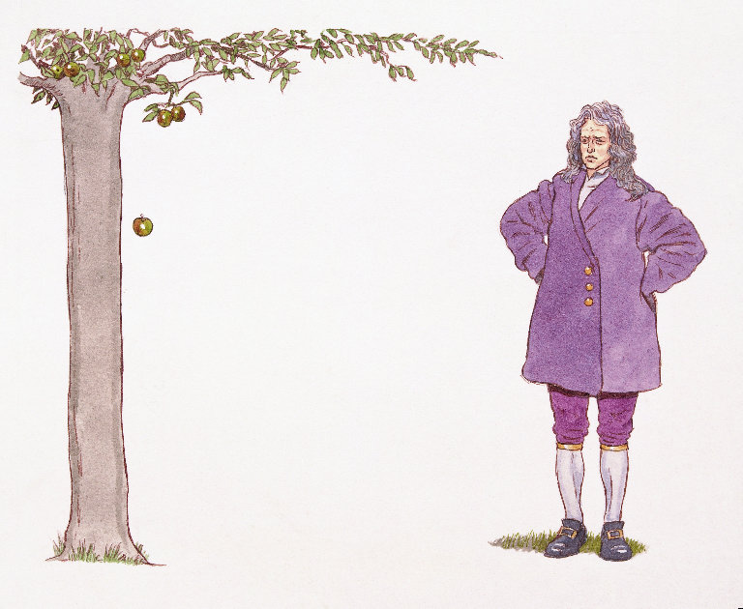
Sir Isaac Newton
1665 = plague closed his university & he was forced to go home to his family
Sitting in his garden one day, he saw an apple fall -- helped him develop his theory of gravity
1687 = published theories about gravity
Prevents objects from flying off the Earth; also holds the solar system together

Slide 15
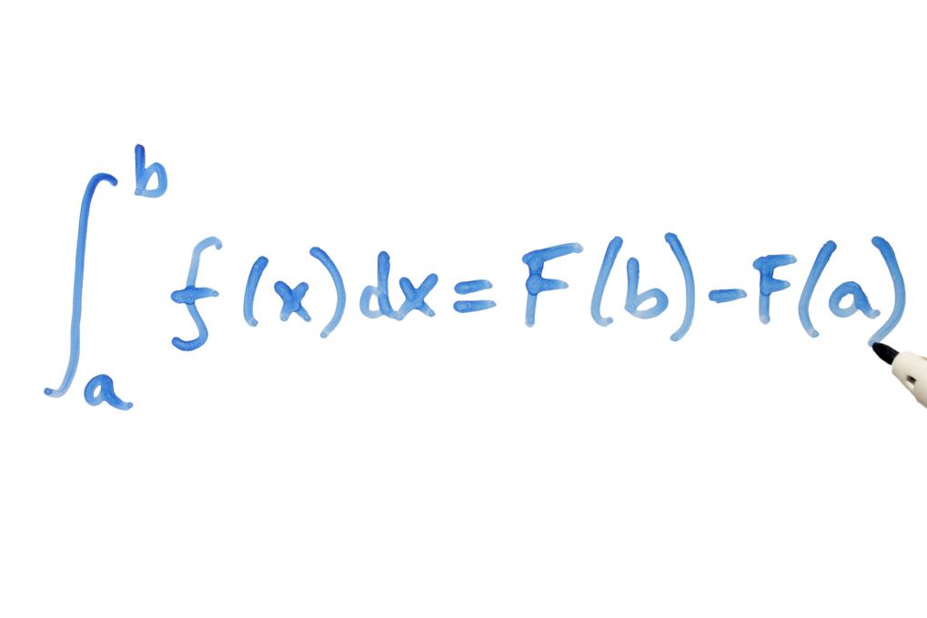
Sir Isaac Newton
Formulated modern laws of motion and mechanics
Developed calculus = system of math that calculates changing forces or quantities
Proved that math can be used to explain the universe

Slide 16
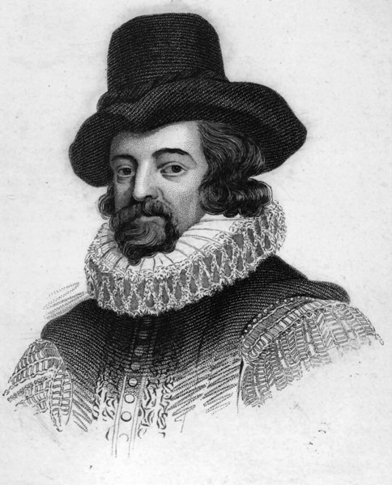
Francis Bacon
English philosopher
Truth found through investigation & evidence
Helped develop scientific method
1. Observe
2. Make hypothesis
3. Test hypothesis
4. Conclusion

Slide 17
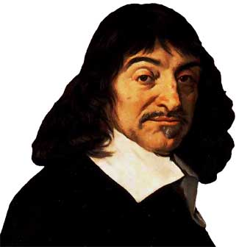
Rene Descartes
French philosopher & mathematician
Truth gained through mathematics and logical deduction (reason)
Invented analytic geometry
Famous quote = “I think, therefore I am.”

Slide 18
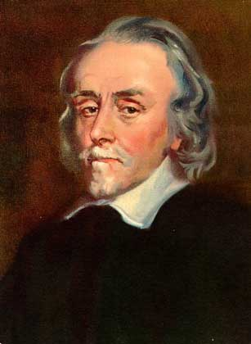
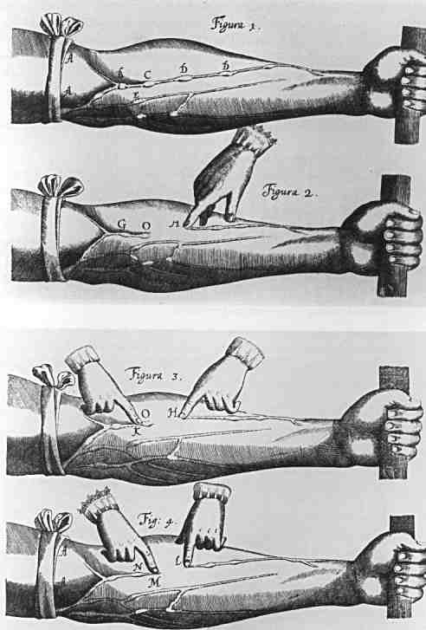
William Harvey
English physician
Concluded that blood circulates throughout the body, pumped by the heart and returning through the veins
Before = people thought the liver digested food & processed it into blood

Slide 19
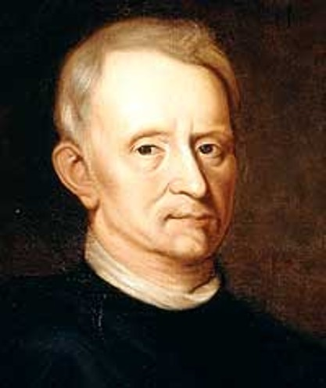
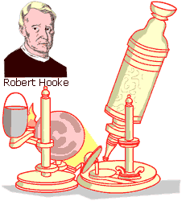
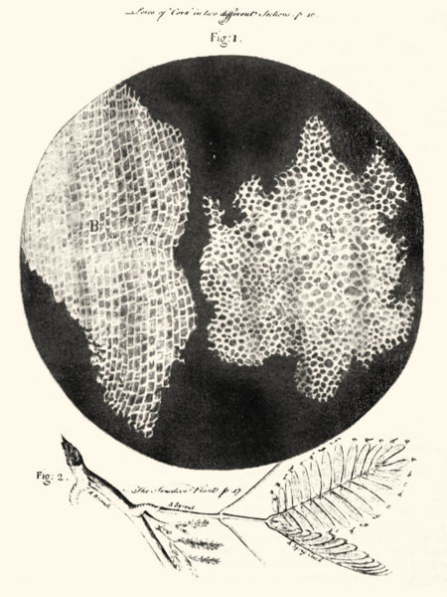
Robert Hooke
English scientist
Discovered the cell
Used new microscope -- recognized cells in vegetable tissues

Slide 20
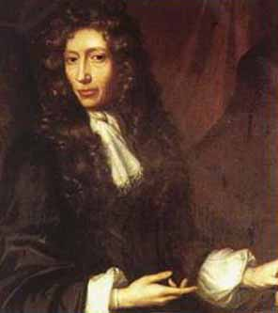
Robert Boyle
Irish chemist
Established chemistry as a pure science
Proved air wasn’t a basic element
Defined what an element is = something that can’t be broken down into simpler parts
Challenged alchemy = trying to turn lead into gold

Slide 21
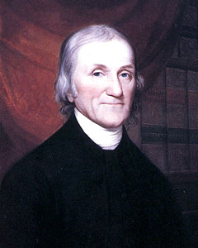
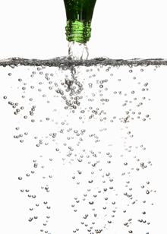
Joseph Priestley
English chemist & clergyman
Did experiments about the properties of air and discovered the existence of oxygen
His studies on carbon dioxide led to his invention of carbonated drinks (like soda)

