Slide 1
The Arab Empire
AP World History Notes
Chapter 8

Slide 2
In terms of Period 3 empires just remember…
M&M’s
Muslims and Mongols

Slide 3
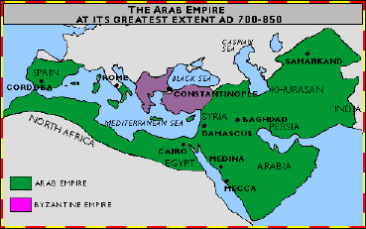
The Arab Empire
Stretched from Spain to India
Extended to areas in Europe, Asia, and Africa
Encompassed all or part of the following civilizations:
Egyptian, Roman/Byzantine, Persian, Mesopotamian, and Indian
With the expansion of the Arab Empire came the spread of:
Islamic faith
Arabic language
Culture of Arabia

Slide 4
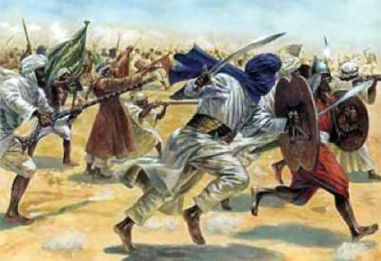
War and Conquest
650s = Arab forces defeated the Persian Empire and took over about half of Byzantium’s territories
Both had been weak for a long time due to fighting with each other
Early 700s = Arab forces swept through North Africa, conquered Spain, and attacked southern France
Early 700s = Arab forces reached the Indus River and took over some major oases towns in Central Asia

Slide 5
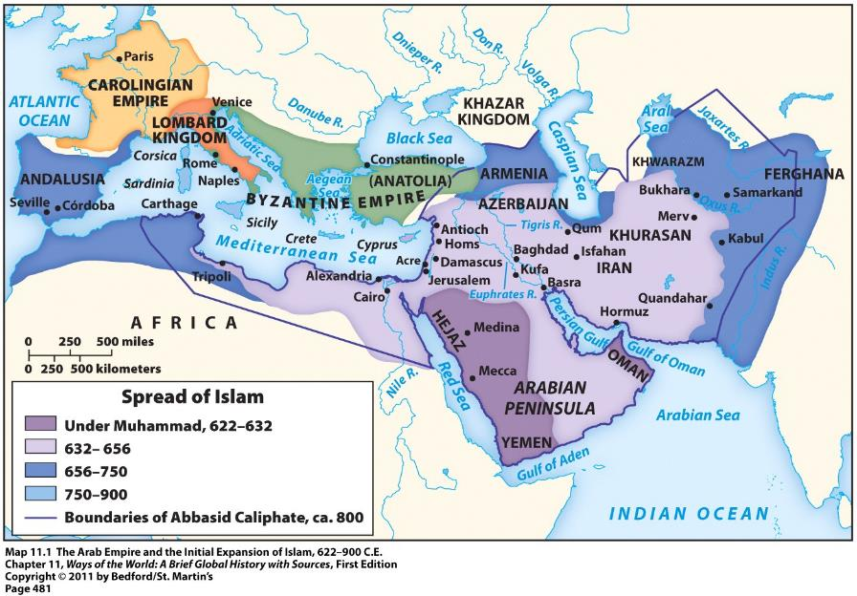

Slide 6
War and Conquest: Motives
Merchants wanted access to profitable trade routes and wealthy agricultural regions
Individuals wanted to gain wealth and social promotion
Expansion provided a common task for the Islamic community (umma) that was on the verge of falling apart after Muhammad’s death
Spread of Muslim faith and righteous government across the world

Slide 7
War and Conquest
Conversion to Islam not forced on anyone in the Arab Empire
In fact: Zoroastrians, Jews, and Christians all considered “people of the book” and were given the status of dhimmis (protected subjects)
In the 400s years following Muhammad’s death, millions of individuals and many whole societies with the Arab Empire adopted Islam

Slide 8
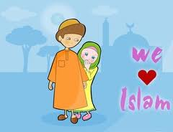
Widespread Conversion to Islam – WHY?
Not such a dramatic change for many Zoroastrians, Jews, and Christians
Already familiar with ideas of: monotheism, heaven, hell, final judgment, divine revelation, fasting, ritual prayer, etc.
Islam sponsored by a powerful state → Wealth and prestige of Arab Empire attracted people
Successful conquest called into question the power of old gods; perhaps Allah really is all-powerful
Many incentives for converting
Ex: Didn’t have to pay jizya = tax on non-Muslims
Ex: Could hold official positions; social mobility

Slide 9
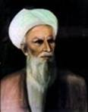
Divisions and Controversies
The “Rightly Guided Caliphs” (632 – 661)
First 4 caliphs after Muhammad
(Caliph = the political and religious leader of the Islamic community)
Close companions of Muhammad
Chosen by Muslim elders of Medina
Division surfaced almost immediately
Sunni vs. Shia Muslims
Abu Bakr
The 1st Rightly
Guided Caliph

Slide 10
Sunnis vs. Shi’ites
Believe the caliph is the rightful political and military leader of Islam
Believe the caliph should be chosen by the Islamic community
Believe the caliph can be any devout Muslim
Religious authority comes from the larger Islamic community; particularly ulama = religious scholars
Believe that the leader of the Islamic community should be a blood descendant/relative of Muhammad
Religious authority comes from prayer leaders called imams
Imams = only ones that can correctly interpret divine revelations and Islamic law

Slide 11
About 90% of Muslims are Sunni

Slide 12
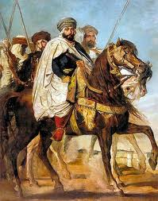
Islamic Caliphs
As the Arab Empire grew, caliphs were transformed from modest Arab chiefs into absolute, all-powerful monarchs
Elaborate court rituals
Complex bureaucracy
Standing army
Centralized systems of taxation and money
2 major ruling dynasties came to control the Arab Empire during this time = Umayyad dynasty and Abbasid dynasty

Slide 13
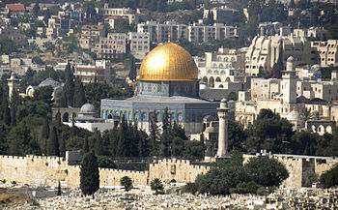
Umayyad Dynasty (661 – 750)
Vast expansion of Arab Empire
Caliphs became hereditary rulers
Empire’s capital moved from Medina to Roman/Byzantine city of Damascus in Syria
Ruling class = Arab military aristocracy
The Dome of the Rock
Built in Jerusalem in 691 CE
Built by Umayyad Caliph Abd al-Malik

Slide 14
Umayyad Dynasty (661 – 750)
Overthrown because:
Non-Arabs resented their status as second-class citizens
Shia Muslims believed Umayyad caliphs were illegitimate
Many Arabs protested the luxurious living of their rulers

Slide 15
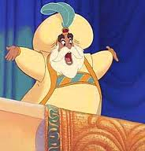
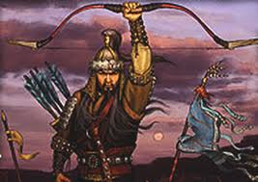
Abbasid Dynasty (750 – 1258)
And no, we can’t watch Aladdin OR Mulan in class.
Built up a new capital for the empire in Baghdad
Non-Arabs now played a prominent role
Persian culture became the culture of Islamic elites
Political unity = didn’t last long
By the mid-800s = many local governors or military commanders asserted autonomy over their regions
Islamic world fractured into multiple “sultanates”
Dynasty officially ended when conquered by the Mongols in 1258

Slide 16
Central Question in the Empire: What does it mean to be a Muslim?
Answer = strict adherence to the sharia = Islamic religious and civil law
Sharia created based on the Quran, Muhamad, and religious leaders.
Sharia addressed virtually every aspect of life; Examples:
Guidance for prayer and ritual cleansing
Treatment of slaves
Rules for political life
Rules for marriage, divorce, and inheritance
Rules for business and commercial practices

Slide 17
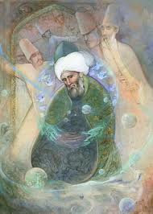
Sufis
Muslims who believed that the wealth and success of Islamic civilization was a deviation from the purer spirituality of Muhammad’s time
Searched for a direct and personal experience with the divine
Rejected the material world
Meditated on the words of the Quran

Slide 18
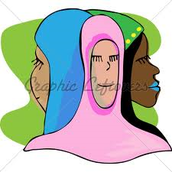
Women and Men in Early Islam
According to interpretations of the Quran made by Muslim scholars:
Spiritually → men and women are equal
Socially (especially in marriage) → women are inferior to men and should obey them
The Quran provided a mix of rights, restrictions, and protections for women

Slide 19
Women and Men in Early Islam
Examples of rights & protection for women within the Quran include:
Rights to dowries and some inheritances
Control over their own property
Marriage = must be consensual
Women could divorce men

Slide 20
Growing Restrictions
Occurred during the Abbasid dynasty
Arab Empire grew in size, wealth, and splendor
Result = role of women became more limited
Applied to upper-class women
Lower-class women = didn’t have servants; had to leave the house for shopping or work
These restrictions stemmed from the traditions and cultures within the Arab Empire; NOT the Quran itself

Slide 21
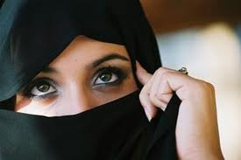
Examples of the Growing Restrictions
Women now expected to pray at home instead of in public mosques
Veiling and seclusion of women became standard practice
Separate living quarters in wealthy homes for women
“Honor killing” = women killed by male relatives if they violated a sexual taboo

Slide 22
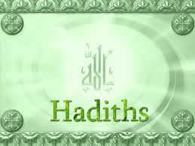
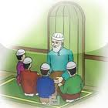
The Hadiths
The Hadiths = traditions about the sayings or actions of Muhammad
Became an important source of Islamic law
Negative view of women → weak, deficient, etc.

