Slide 1
Silver and Fur Trade 1450-1750
AP World History Notes
Chapter 16
“Global Commerce”

Slide 2
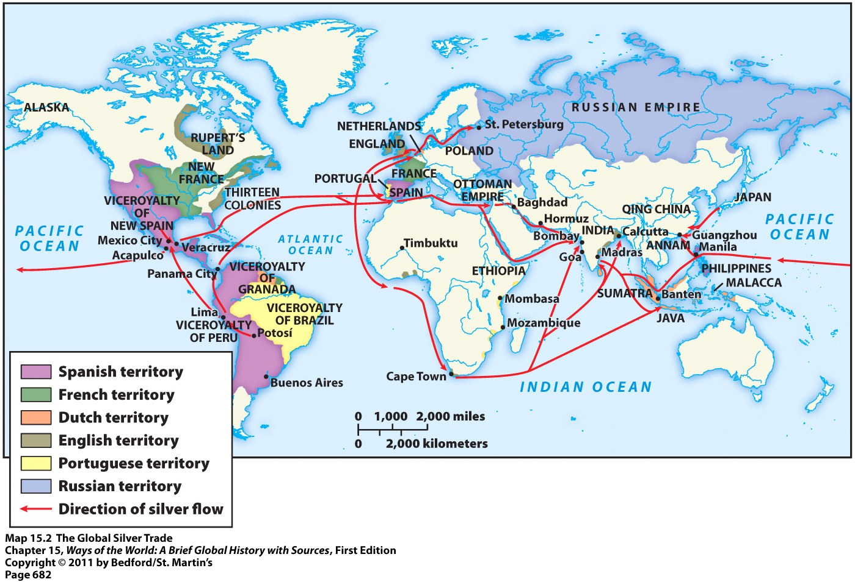
Silver and Global Commerce
Silver = 1st major commodity to be exchanged on a truly global scale

Slide 3
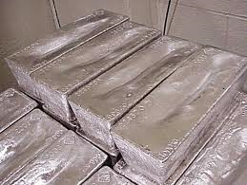
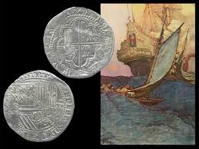
Silver and Global Commerce
Mid-1500s = rich silver deposits discovered in Bolivia and Japan
Spanish America = produced about 85% of the world’s silver
Major link in silver trade = Philippines
Silver = mined in Bolivia → sent to Acapulco in Mexico where it was loaded onto cargo ships → then shipped to the Philippines

Slide 4
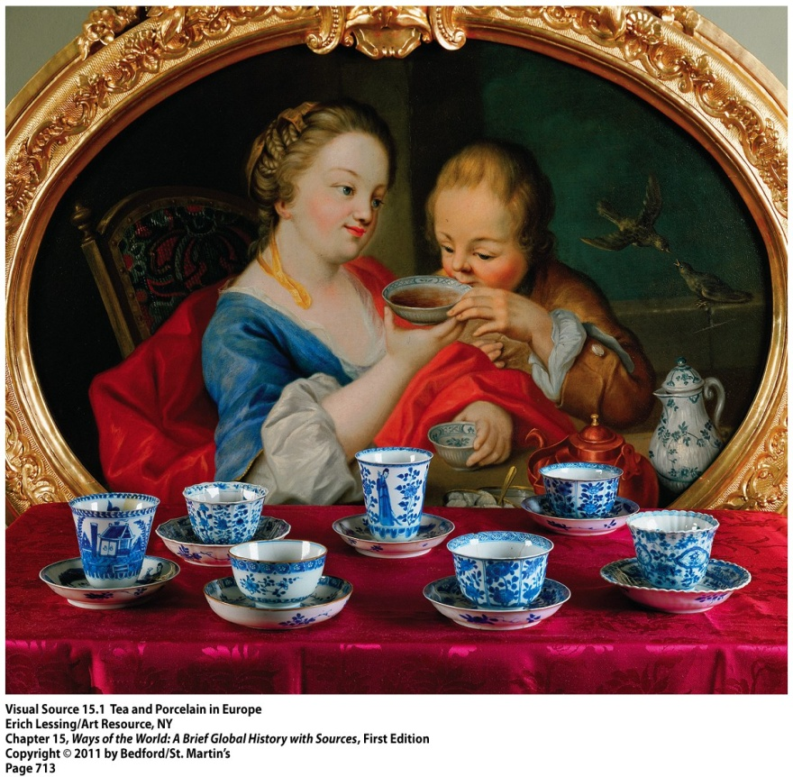
Silver and Global Commerce
Most of the world’s silver supply = ended up in China
Foreigners could now purchase in-demand Chinese goods with silver
Many merchants flocked to Manila (capital of the Philippines) to sell Chinese goods there for silver
Furthermore → in 1570s = China issued new single tax that all people were required to pay in silver
Meant that more goods needed to be sold by them = more silver in China = taxes could be paid
Chinese porcelain in Europe

Slide 5
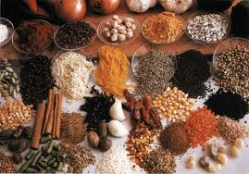
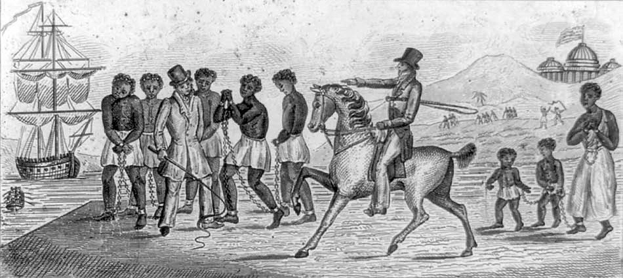
Silver and Global Commerce
Besides Chinese goods, silver was also used to purchase:
Spices in Southeast Asia
Slaves from Africa

Slide 6
Silver: Impact on Spain
Positives
Negatives
Brought wealth and power to Spain
Rulers could now pursue military and political ambitions in Spain and the Americas
Supported the Spanish Empire
Over time → too much silver flowed into Spain → caused inflation = value of silver went down and prices went up
When the value of silver dropped worldwide (early 1600s), Spain began to weaken and lose power

Slide 7
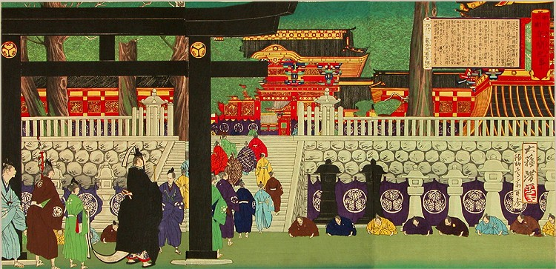
Silver and Japan
Japan put its silver-generated profits to good use:
Shoguns used it to defeat rival feudal lords and unify Japan
Shoguns worked with merchant class to develop a market-based economy
Invested in agricultural and industrial enterprises
Protected and renewed Japan’s dwindling forests
Procession of Japanese shoguns in 17th century

Slide 8
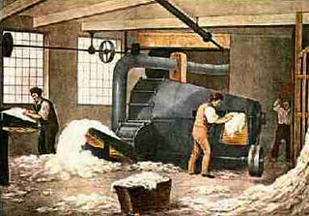
Silver and Japan
Simultaneously = millions of families (in 18th century) took steps to have fewer children
Results for Japan = slowing of population growth; prevention of ecological crisis; bustling, commercialized economy
Laid the groundwork for Japan’s Industrial Revolution in the 19th century

Slide 9
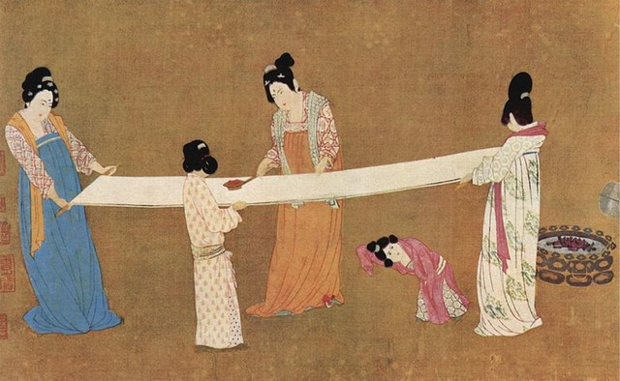
Silver and China
Impact of silver on China’s economy:
Led to more commercialization
In order to pay silver tax, people had to sell something → led to economic specialization
Ex: Selling just rice or just silk
Impact on China’s environment:
More land = used to grow cash crops
Result = loss of about ½ of China’s forests
Chinese women making silk

Slide 10
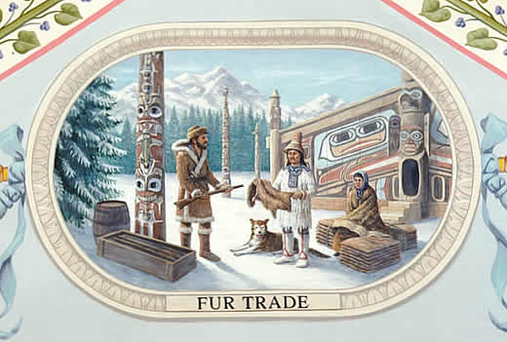
Fur in Global Commerce
By 1500 = diminished supply of fur-bearing animals in Europe due to population growth and agricultural expansion
“Little Ice Age” = period of cooling temperatures and harsh winters at the time
Result of these conditions = high demand for furs
Result of this demand = pushed prices for furs higher = incentive for traders to sells it

Slide 11
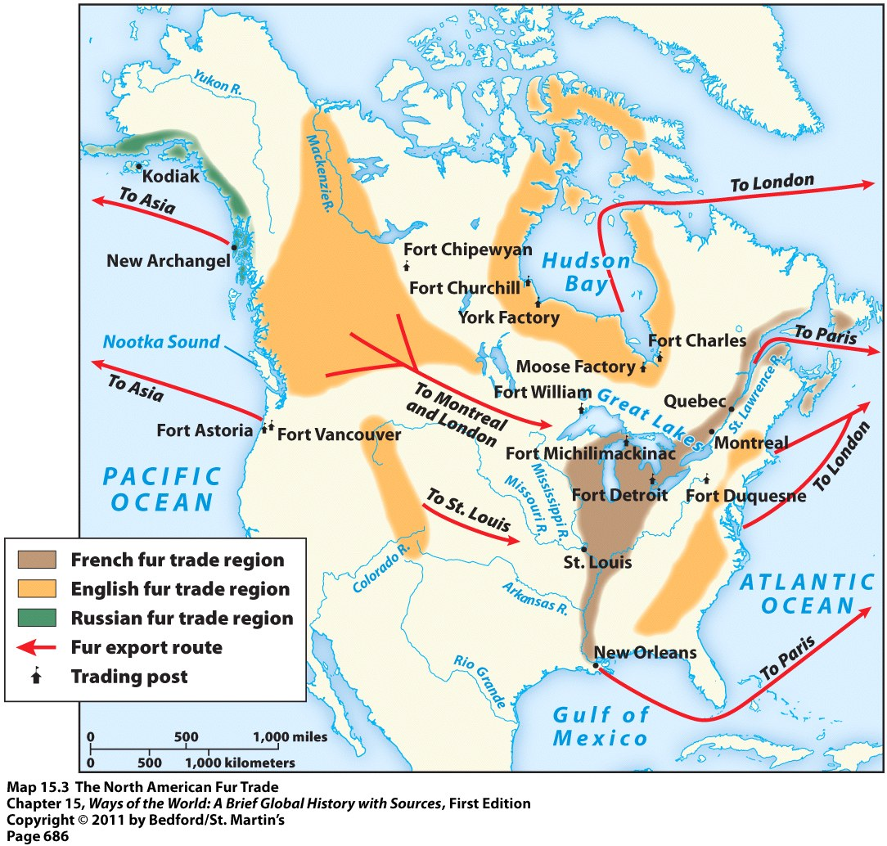
Fur Trade in North America
Fur trade = very competitive
French = in St. Lawrence Valley, around Great Lakes, and along Mississippi River
British = Hudson Bay region and along Atlantic coast
Dutch = along Hudson River (present-day New York)

Slide 12
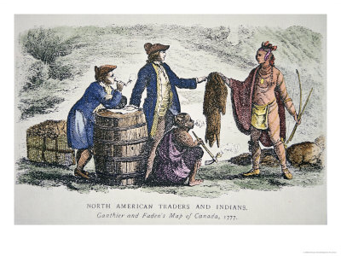
Fur Trade in North America
Actual hunting, trapping, processing, and transporting of animals/furs = done by Native Americans
Brought them to European coastal settlements or trading posts
Europeans then sold the furs abroad
In return for the furs, Europeans gave Native Americans: guns, blankets, metal tools, rum, and brandy

Slide 13
Fur Trade in North America: Impact on Native Americans
Positives
Negatives
Received items of real value (ex: copper pots, metal axes, etc.)
Strengthened their relationships with neighboring peoples
Enhance authority of chiefs → could give their followers gifts
Protected them (for a while) from enslavement, extermination, or displacement
Exposure to European diseases
Competition between tribes for furs = resulted in conflict and warfare
Often got caught up in European rivalries/conflicts
Became dependent on European goods; never learned to make them themselves
Alcohol-related problems resulting from influx of rum and brandy

Slide 14
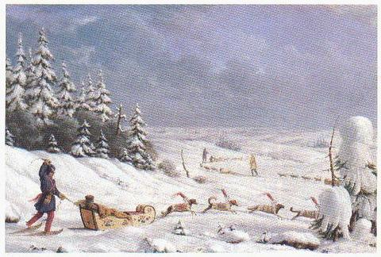
Siberian Fur Trade
Siberia (in Russia) = major source of furs for Western Europe and the Ottoman Empire
Brought wealth to the Russian state and many private merchants, trappers, and hunters
Transporting furs across Siberia

Slide 15
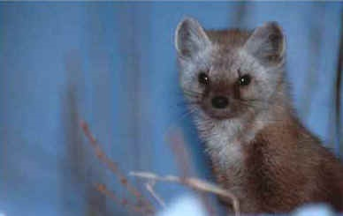
Siberian Fur Trade
Consequences for native Siberians:
Exposure to new diseases
Became dependent on Russian goods
Settlers encroached on their native lands
Depletion of many species of fur-bearing animals
A Russian Sable

Slide 16
Fur Trade North America vs. Siberia
North America
Siberia
Several European nations competing
Obtained furs using negotiations and trade with Native Americans
Only Russians and native Siberians getting furs
Obtaining furs themselves; no middlemen
Russian authorities imposed a tax (payable in furs) on all Siberian men between 18 and 50 → took hostages (who were sometimes executed) if taxes not paid

