Slide 1
Period One
Technological and Environmental Transformations to 600 B.C.E.

Slide 2
Geography and Period 1: Technological and Environmental Transformations to 600 CE
Types of Maps to use
Key Concepts
Big Geography and the peopling of the Earth (1.1)
Interactive map of Genographic project
https://genographic.nationalgeographic.com/genographic/atlas.html?era=e003

Slide 3
Geography and Period 1: Technological and Environmental Transformations to 600 CE
Key Concepts
1.2. Location and reason for emergence of agriculture in various locations
-> led to new economic and social systems
-> agriculture and pastoralism were transformative
-> technological innovations led to improvements (pottery, plows, woven textiles, metallurgy, wheels)
Types of Maps to use

Slide 4
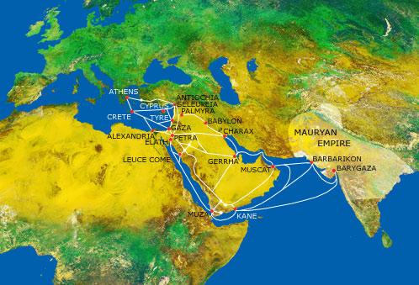
Geography and Period 1: Technological and Environmental Transformations to 600 CE
Types of Maps to use
Key Concepts
1.3 I. Location of core and foundational civilizations (and early trade networks)
Mesopotamia (trade with Indus Valley)
Egypt (trade with Nubia)
Mohenjo-Daro and Harappa
Shang
Olmecs
Chavin

Slide 5
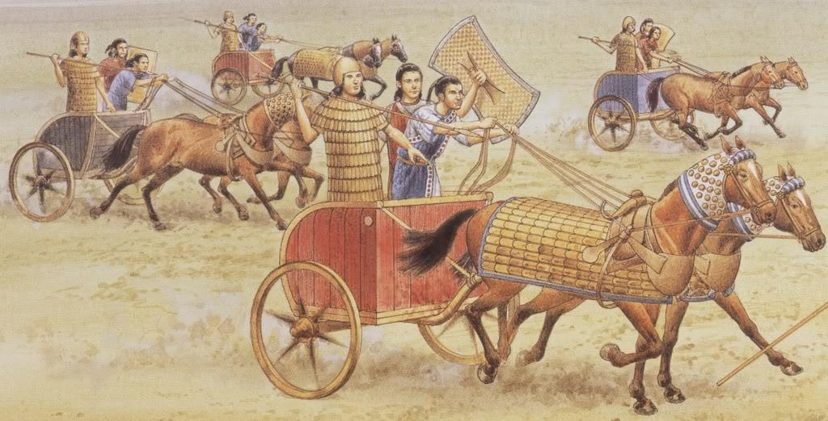
Geography and Period 1: Technological and Environmental Transformations to 600 BCE
Illustrative examples of new weapons and new modes of transportation (choose one of each)
Key Concepts
1.3 II. First states emerged, including early regions of state expansion or empire building like:
Mesopotamia, Babylonia, and the Nile Valley.
Hittites had an advantage due to access to iron.

Slide 6
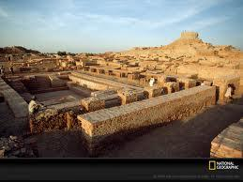
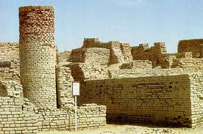
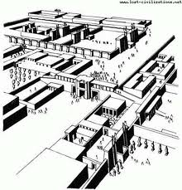
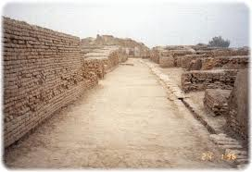
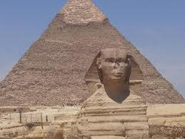
1.3 III. Culture played a role in unification through laws, language, literature, religion, myths, and monumental art
.Early civilizations developed monumental architecture and urban planning
Illustrative examples of monumental architecture and urban planning (choose one – ziggurats, pyramids, temples, defensive walls, streets and roads, sewage and water systems)

Slide 7
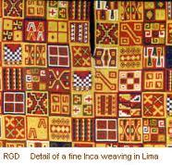
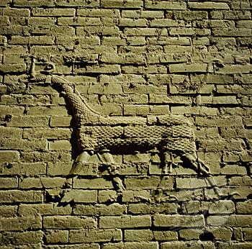
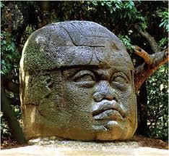
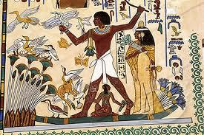
1.3 III. Culture played a role in unification through laws, language, literature, religion, myths, and monumental art
Illustrative examples of arts and artisanship (choose one—sculpture, painting, wall decorations, and elaborate weaving)
Key Concepts
Elites, both political and religious, promoted arts and artisanship.

Slide 8
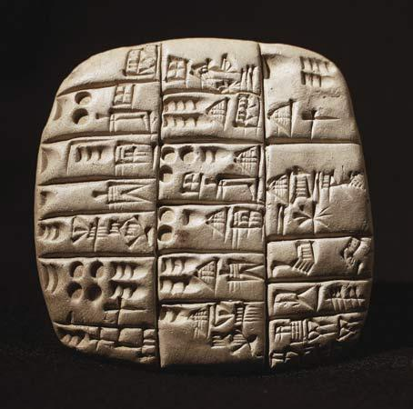
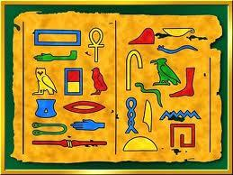
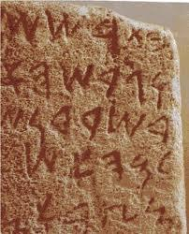
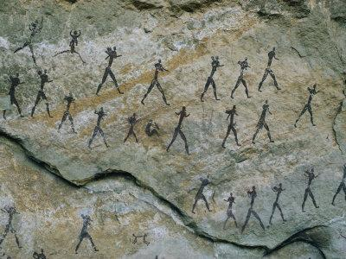
1.3 III. Culture played a role in unification through laws, language, literature, religion, myths, and monumental art
Illustrative example of record keeping(choose one: Cuneiform, hieroglyphics, pictographs, alphabets, or quipu)
Key Concepts
Systems of record-keeping arose independently in all early civilizations and then diffused.

Slide 9
Geography and Period 1: Technological and Environmental Transformations to 600 BCE
Unification through culture, continued
Trade expanded from local to regional and transregional including trade between Egypt and Nubia and Mesopotamia and the Indus valley.
Social and gender hierarchies grew more rigid with state expansion and urbanization.
1.3 III.
States developed legal codes including Code of Hammurabi.
New religious beliefs emerged including: Vedic religion, Hebrew monotheism, and Zorastrianism

Slide 10
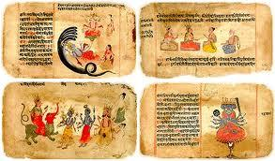
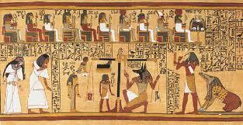
1.3 III. Culture played a role in unification through laws, language, literature, religion, myths, and monumental art
One Illustrative example of literature (choose one: Epic of Gilgamesh, Rig Veda, Book of the Dead)
Key Concepts
Literature was a reflection of culture.

