Slide 1
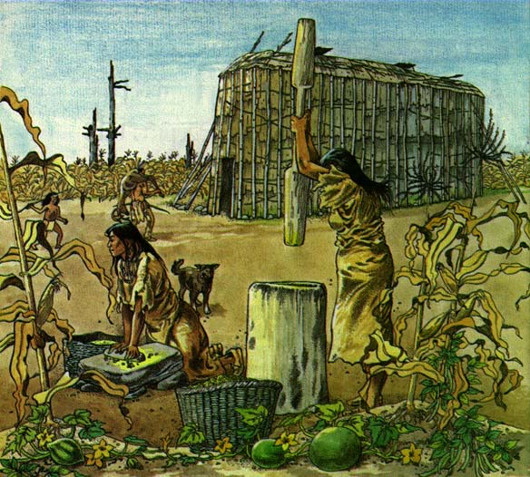
Neolithic Revolution (Beginnings-600 BCE)

Slide 2
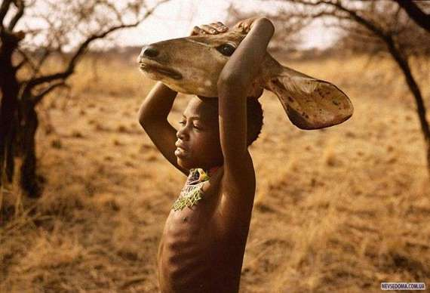
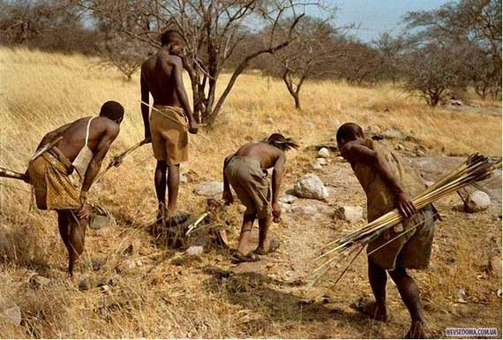
Beginnings of Mankind
Homo Sapiens appear around 250,000 years ago.
Early humans formed groups of hunter-gatherers (foragers) to get food to survive.
Everyone worked to survive.
Nomadic- groups migrate (move from place to place) when food supplies run low.

Slide 3
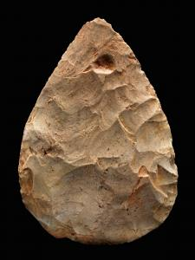
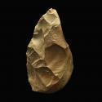
Early Man (250,000-10,000 BCE)
Crafted tools to adapt to environments:
Stone, bone, antler, wood materials.
Axes, spears, arrows, fishing poles.
Clothing made from animals to survive.
Some groups were not able to survive on their own, exchanged peoples and ideas.
Most societies were egalitarian- equal social roles between men and women.
Early period called the Paleolithic (Old Stone Age)

Slide 4
Human Migration Starting 100,000 Years Ago

Slide 5
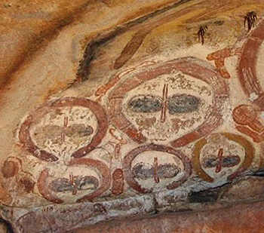
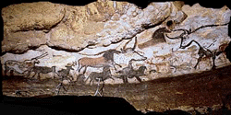
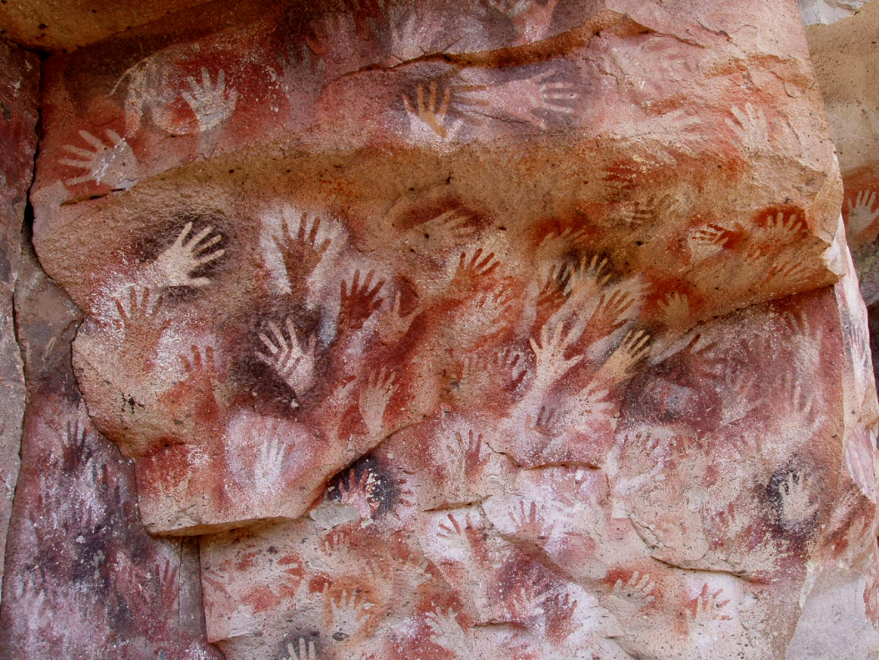
Paleolithic Art

Slide 6
Changes from the Ice Age Ending (11,000 Years Ago)
Climate becomes warmer, wetter.
Larger mammals and other hominids go extinct.
Increase in wild plant life and habitable regions.
First animal domesticated (tamed and kept as a pet), the wolf.

Slide 7
The Neolithic Revolution (9,000-3,500 BCE)
Humans begin to learn how to domesticate (cultivate for food) plants.
Humans develop a sedentary (non-migratory) lifestyle to grow plants.
Some humans become pastoral nomads- raising livestock but migrating with their animals.
Often clash and fight with sedentary farmers.

Slide 8
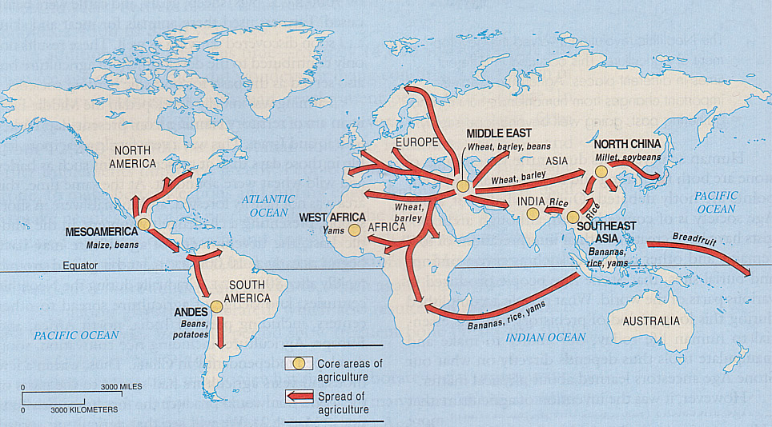
Agriculture Slowly Spreads

Slide 10
Emerging Changes
Food surplus reduced amount of humans needed to work.
Humans begin to specialize- work on different tasks they are good at.
Pottery, art, building homes, weapons.
Kilns for pottery eventually used to work metals and create metal tools and weapons.
Bronze tools and weapons become dominant beginning the Bronze Age.

Slide 11
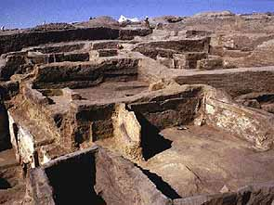
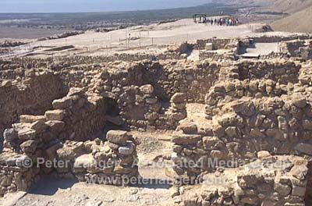
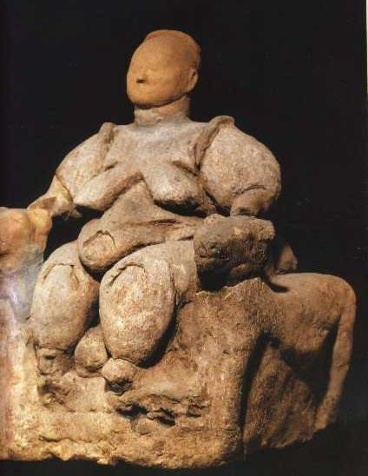
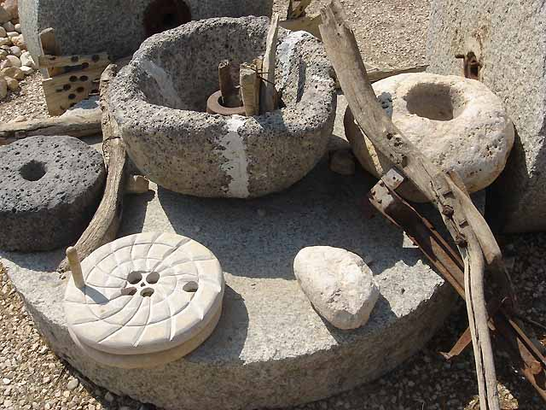
First Towns Develop
Çatal Hüyük
(Modern Turkey)
First settled:
c. 7000BCE
Jericho
(Modern Israel)
First settled:
c. 7000BCE
relatively egalitarian---no evidence of
labor specialization or gender distinction

Slide 12
Advanced Civilization: The Next Step?
By 3500BCE, relatively large, advanced preliterate societies develop along Indus, Huang He, Nile, and Tigris & Euphrates Rivers.
As societies grow in size and need, sedentary human beings are again faced with pressures to adapt to changing natural and human environments.

Slide 13
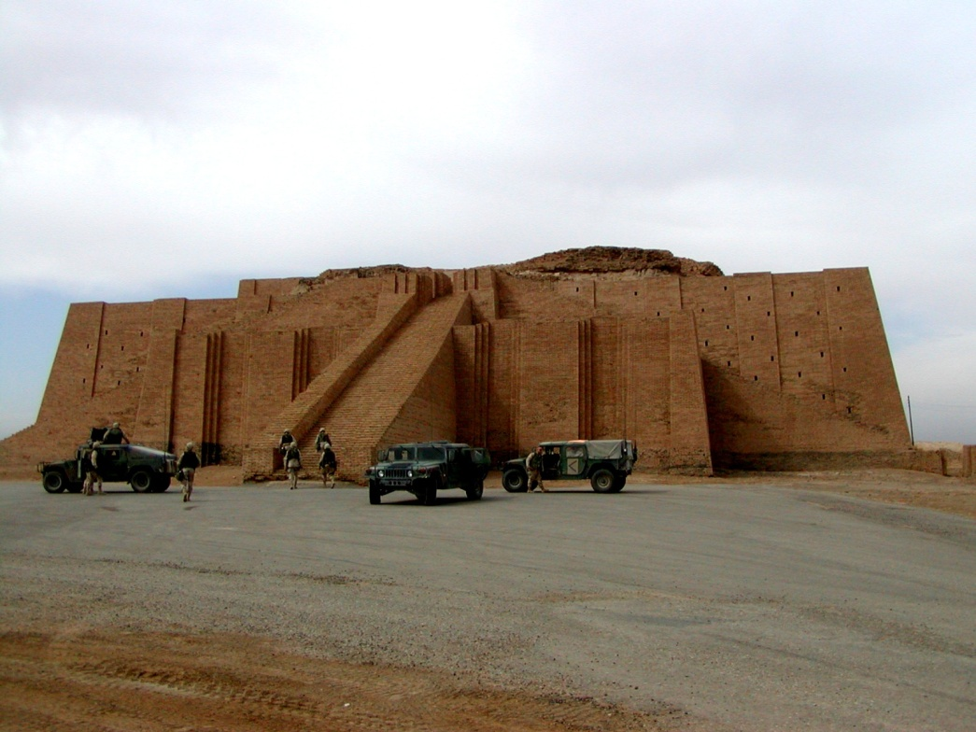
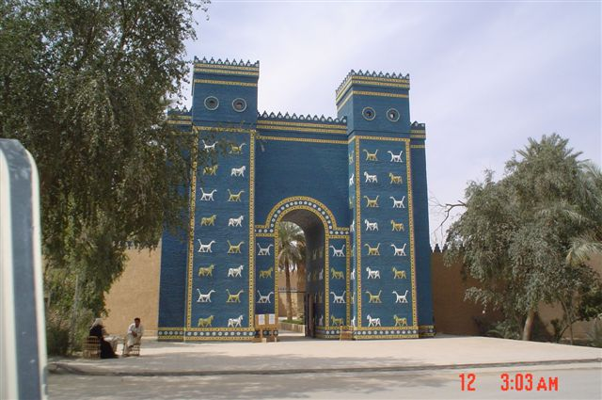
The six characteristics of civilization
1. Advanced cities
population size (10,000s)
trade/ administrative centers
religious centers

Slide 14
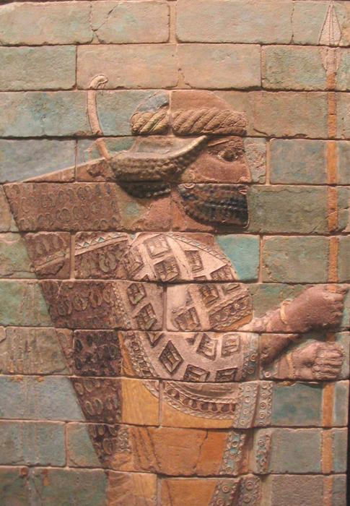
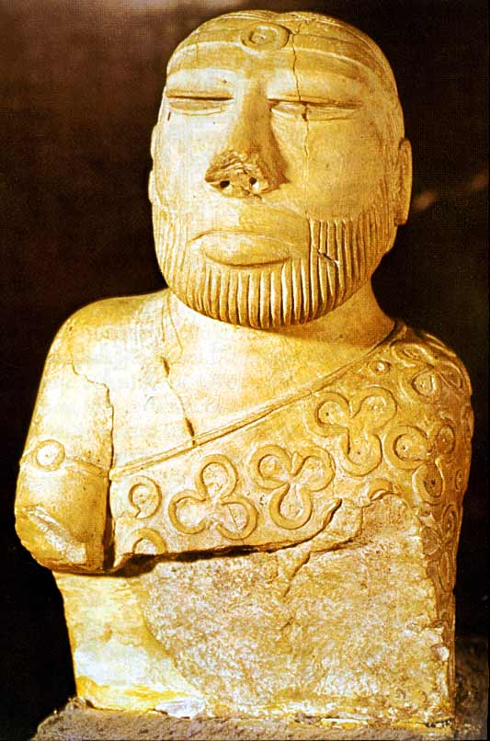
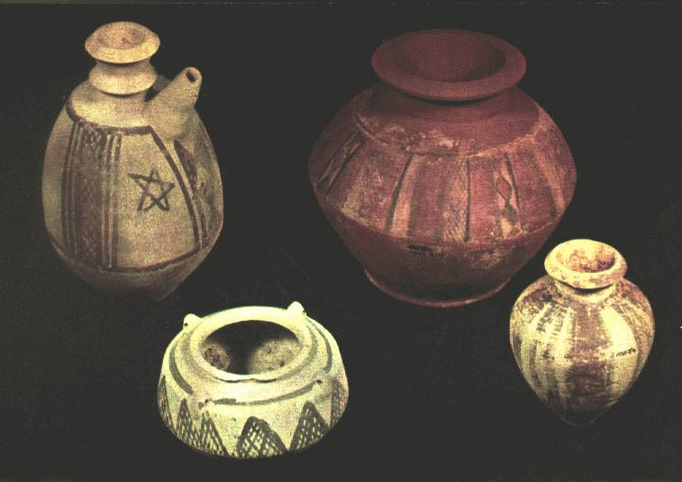
2. Specialized Workers
Lived in cities, fed by surplus food
Artisans, shopkeepers, soldiers, officials, rulers, priests

Slide 15
3. Social Classes
Rulers and priests
nobles
Artisans and merchants
farmers
Slaves
Invert these two
if talking about
China

Slide 16
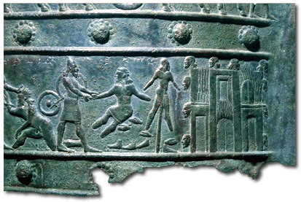
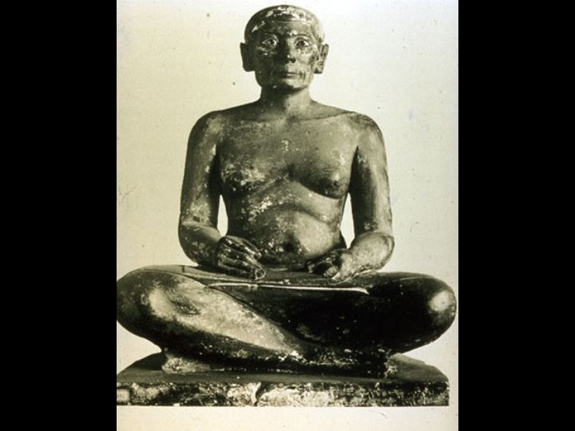
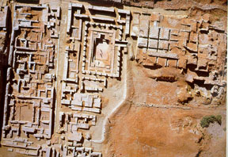
4. Complex Institutions
the long- lasting patterns of organization
Government
Religion
Education
military

Slide 17
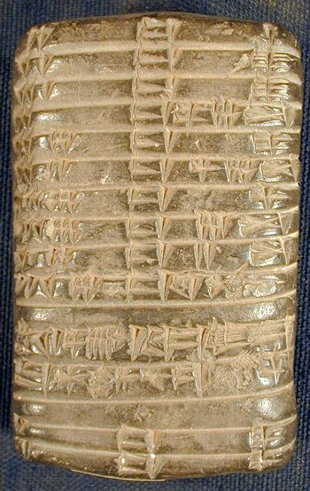
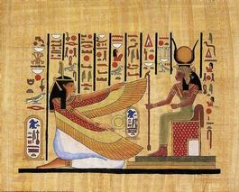
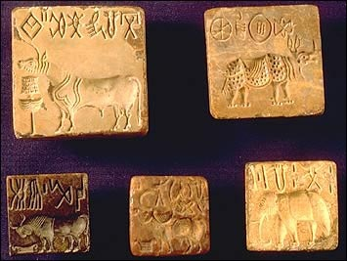
5.Recordkeeping/writing
Keep track of events, time, business transactions, religious rituals

Slide 18
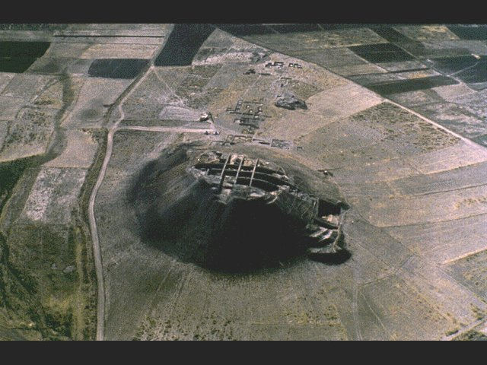
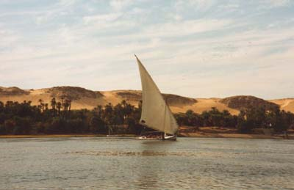
6. Advanced technology
Monumental architecture
Art, public works
New tools

Slide 19
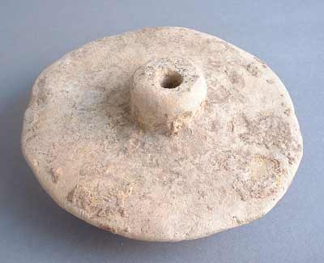
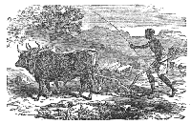
Technological Advancements
 | Wheeled Vehicles Save labor, allow transport of large loads and enhance trade
 | Potters Wheel (c.6000BCE) Allows the construction of more durable clay vessels and artwork
 | Irrigation & Driven Plows Allow further increase of food production, encourages pop. growth

Slide 20
Role of Women “Great Leap Sideways”
Women generally lost status under male-dominated, patriarchal systems.
Women were limited in vocation,
Planting, weeding, harvesting, grinding – fossil evidence
Women may have lacked the
same social rights as men.

Slide 21
Early Human Impact on the Environment
Deforestation in places where copper, bronze, and salt were produced.
Erosion and flooding where agriculture disturbed soil and natural vegetation.
Selective extinction of large land animals and weed plants due to hunting & agriculture.

Slide 22
Costs & Advantages of Agriculture
Advantages | Costs
Steady food supplies Greater populations Leads to organized societies capable of supporting additional vocations (soldiers, managers, etc.) | Heavily dependent on certain food crops (failure = starvation) Disease from close contact with animals, humans, & waste Reduced mobility

Slide 23
What are the consequences?
The Biggest Mistake in Human History?
Hunter-gatherers work about 20% of the day to provide enough food to survive, farmers work about 60% of the day to provide enough to survive. Duh!!!
Divergence between world’s parts grew – despite common origins mankind diverges and distinct cultures emerge

