Slide 1
Islam
AP World History Notes
Chapter 8

Slide 2
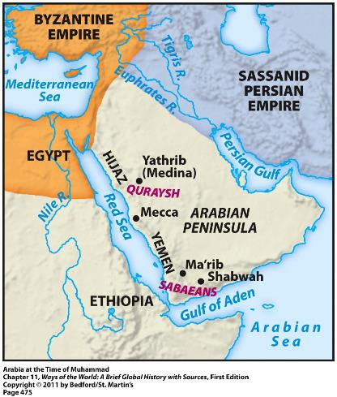
The Homeland of Islam
Originated on the Arabian Peninsula
Had long been inhabited by nomadic Arabs = the Bedouins
Located along important trade routes → Indian Ocean, Mediterranean Sea, etc.
Gave rise to large commercial cities

Slide 3
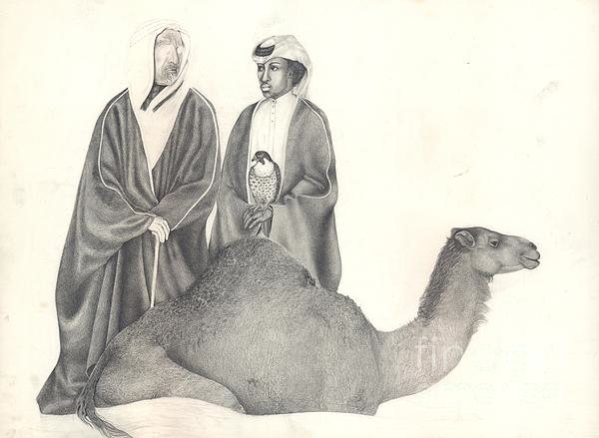
Bedouins
Herded sheep and camels
Lived in fiercely independent clans and tribes
Often engaged in violent wars with each other
Variety of gods and ancestor/nature spirits
Valued personal bravery and group loyalty

Slide 4
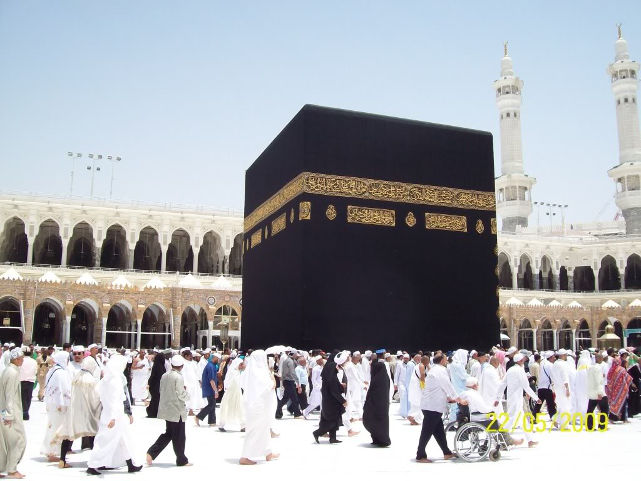
Mecca
Major commercial city
Site of the Kaaba = most important religious shrine in Arabia
Housed representations of about 360 deities
Ruling tribe of Mecca = the Quraysh
Controlled access to the Kaaba
Gained wealth by taxing local trade

Slide 5
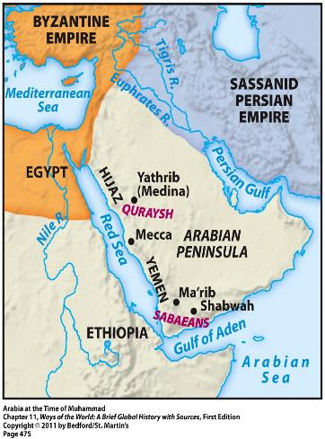
Arabia – Connections to the World
Participation in long-distance trade
Location between the Byzantine Empire (to the northwest) and the Persian Empire (to the northeast)
Result = many Jews, Christians, and Zoroastrians lived among the Arabs in Arabia
Many of their monotheistic ideas began to influence the Arabs

Slide 6
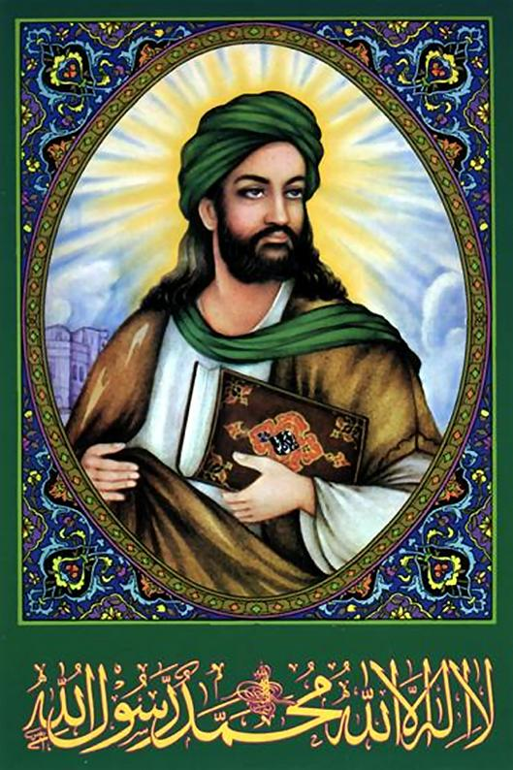
The Messenger
Muhammad (570 – 632 CE)
Born in Mecca
From a Quraysh family
A shepherd and a trader
Troubled by the religious corruption and social inequalities of Mecca
Often withdrew into the mountains to meditate
610 CE = he had an overwhelming religious experience
(Similar to the Buddha and Jesus)
Became convinced he was Allah’s messenger to the Arabs

Slide 7
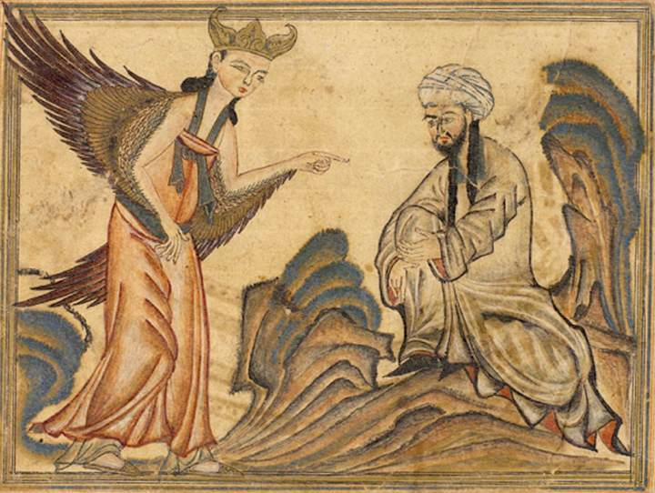
The Messenger
Muhammad claimed to be the “seal of the prophets”
Meant he was the last in a long line of prophets, including Abraham, Moses, Jesus, and others
Said he had God’s FINAL revelation to humankind
Wasn’t trying to start a new faith
More of an invitation to return to the old and pure religion of Abraham

Slide 8
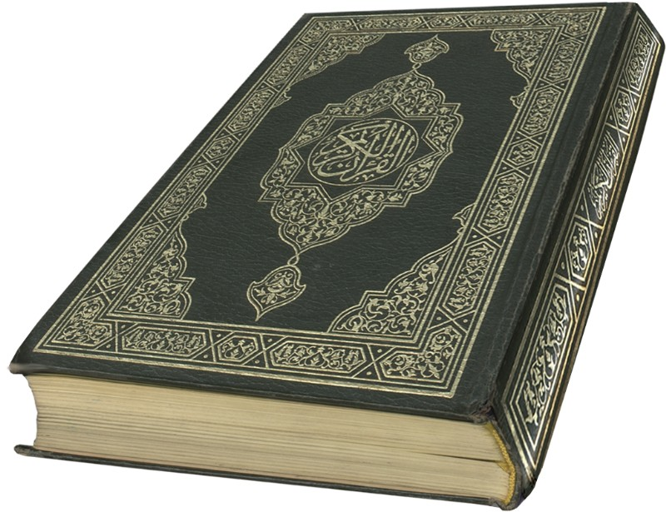
The Message
Muhammad’s revelations began in 610 CE and continued for the next 22 years
Recorded in the Quran = the sacred scriptures of Islam
Monotheistic → Allah is the only God
All-powerful Creator
Good, just, and merciful
Rejected the other deities housed in the Kaaba
Rejected Christian idea of the Trinity

Slide 9
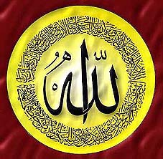
The Message
The Quran rejected:
Hoarding of wealth and materialism
Exploitation of the poor
Corrupt business practices
Neglecting widows and orphans
Abuse of women
The Quran demanded:
Social justice
Equality
Aid to the poor

Slide 10
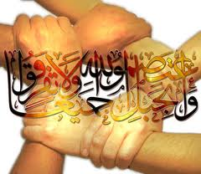
The Message
Primary obligation of all believers = submission to Allah
Not only an individual or spiritual act, but also involved the creation of a whole new society
Umma = the community of all believers
Just and moral society of Islam
Would replace tribal, ethnic, or racial identities

Slide 11
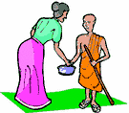
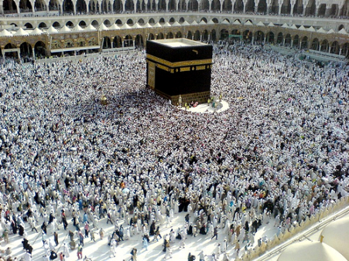
The Message: 5 Pillars of Islam
1) Faith: “There is no god but Allah, and Muhammad is the messenger of God.”
2) Prayer: Should be performed 5 times daily while facing in the direction of Mecca
3) Almsgiving: Supporting the poor and needy of the community
4) Fasting: Occurs during month of Ramadan; no food, drink, or sexual relations from dawn to sundown
5) The Hajj: Pilgrimage to Mecca

Slide 12
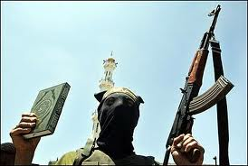
The Message: The 6th Pillar
Jihad = “struggle”
“Greater jihad” = interior personal effort to avoid greed and selfishness, and to strive toward living a God-conscious life
“Lesser jihad” = “jihad of the sword” = belief that the Quran authorized armed struggle against the forces of unbelief and evil
In order to: establish Muslim rule and defend the umma from the threats of infidel aggressors
versus

Slide 13
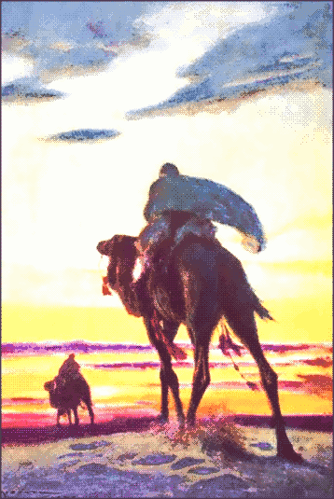
Transformation of Arabia
Muhammad’s message soon attracted opposition from Mecca’s elite families; they didn’t like his:
Claim to be the “messenger of Allah”
Strict monotheism
Call for social reform
Condemnation of business practices
Disloyalty to his own tribe (the Quraysh)
Caused Muhammad and his followers to go to Medina
This is where the umma took shape

Slide 14
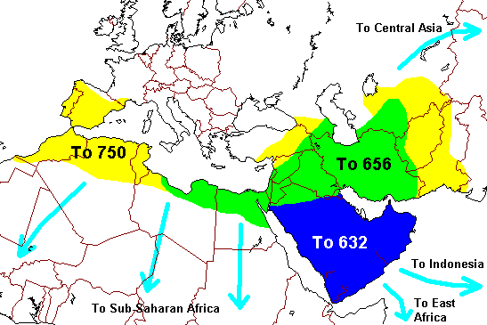
The Islamic Community
Muhammad = both religious and political leader; also led the military
Islamic community expanded throughout Arabia by:
Military conquest
Marriage alliances with leading tribes
Voluntary conversion
By 632 (time of Muhammad’s death), most of Arabia had come under Islamic control

Slide 15
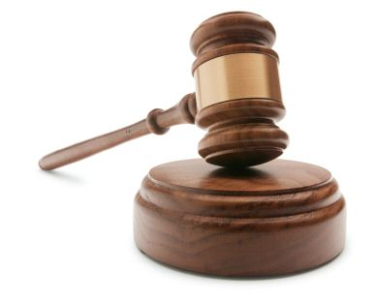
Islamic Law
No distinction between religious law and civil law
ONE LAW = the sharia
Regulated every aspect of life

