Slide 1
Commerce & Culture 500-1500 Sea Roads: The Indian Ocean
AP World History Notes
Chapter 8

Slide 2
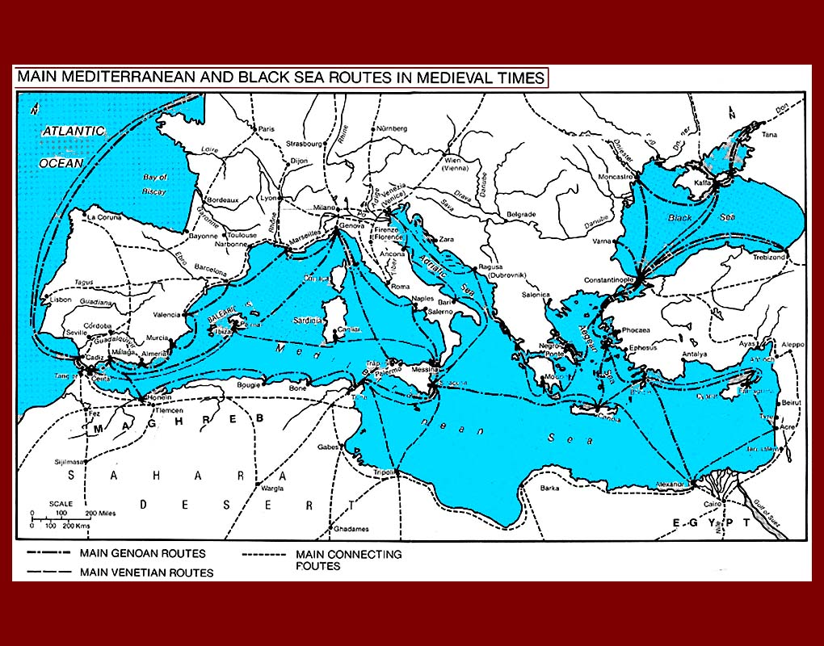
Sea Exchange
Nothing new
Begins with Mediterranean Sea trade
Participants = Phoenicians, Greeks, Romans
Italian city of Venice = major center of commerce

Slide 3
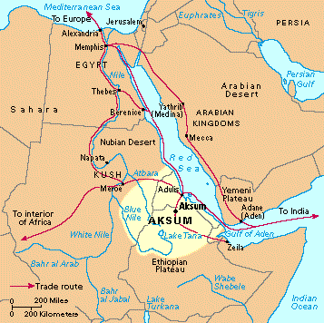
Sea Exchange
Begins with Red Sea trade
Participants = Egyptians, Phoenicians, Greeks, Romans, Africans
Alexandria = major port and city of commerce

Slide 4
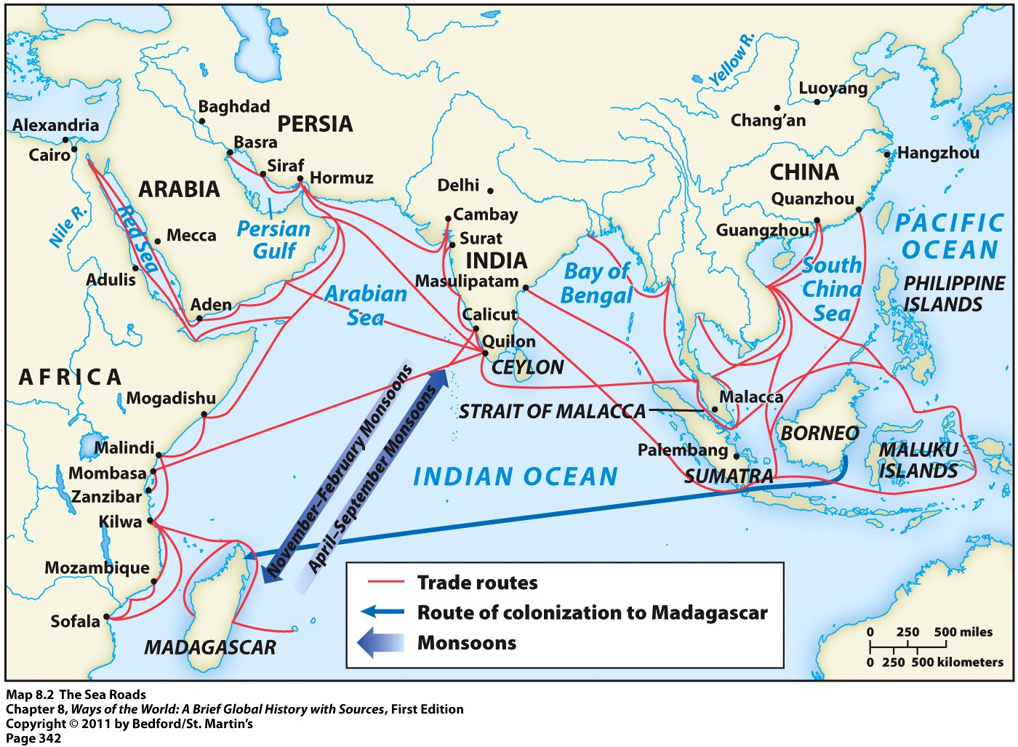
Indian Ocean Exchange

Slide 5
Indian Ocean Exchange
Like the Silk Roads, trade grew because of:
Environmental and cultural diversities in each region
Desire for goods not available at home
Same goods traded from each region as on the Silk Roads
Ex: silk and porcelain from China
Ex: ivory and gold from the African coast
Unlike the Silk Roads: transportation costs much lower
Ships could carry much more at one time than camels
Sea Roads carried more bulk and staple goods → not just luxury items like on the Silk Roads

Slide 6
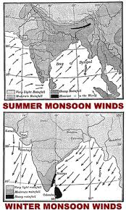
Monsoons
Made Indian Ocean exchange possible
Monsoons = alternating wind currents
Blow predictably eastward in summer months
Blow predictably westward in winter months

Slide 7
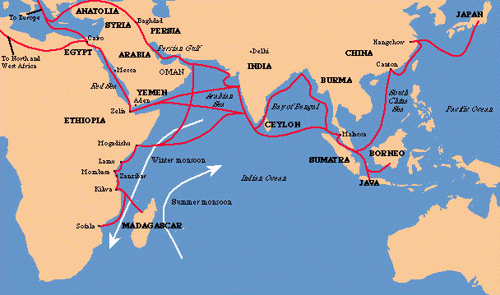
Indian Ocean Exchange
Not between countries
Not between entire regions
IS between individual merchant towns

Slide 8
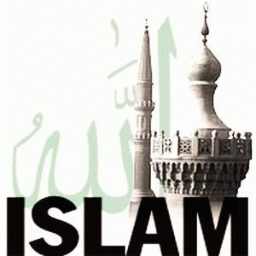
Growth of Indian Ocean Trade
2 major transformations occurred between 500 and 1500 that led to major growth of the Indian Ocean trade network
Economic and political revival of China
Rise of Islam in the 7th century

Slide 9
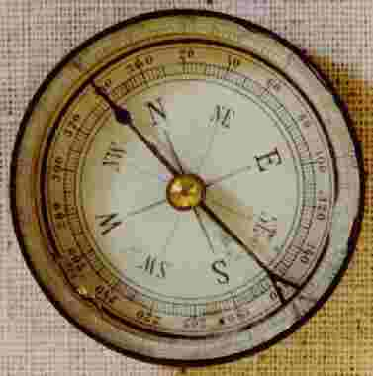
China’s Comeback
4 centuries after the collapse of the Han dynasty
Reestablished a unified government
Encouraged sea trade
Economic growth = allowed Chinese products to pour into trade networks
Technological innovations = larger ships; magnetic compass

Slide 10
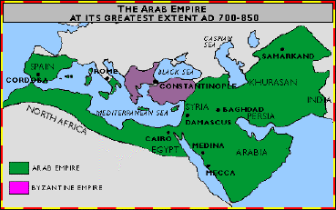
Rise of Islam
Islam = friendly to commercial life (unlike Confucianism)
Creation of an Arab Empire
Stretching from Atlantic Ocean to India
Brought together a wide range of economies in a single political system
Powerful and wealthy empire = continued to stimulate Indian Ocean trade

Slide 11
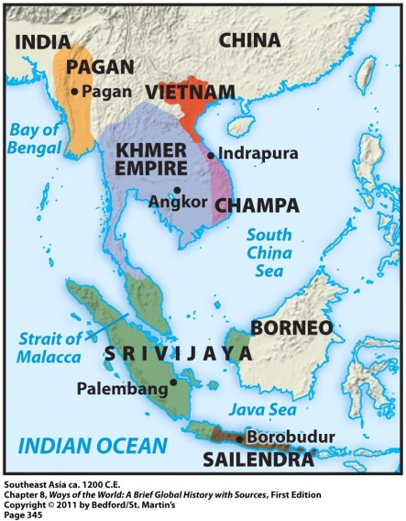
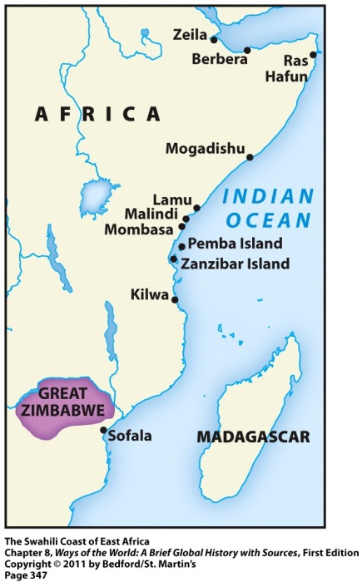
Sea Roads = Change
Indian Ocean trade transformed ALL of its participants in one way or another
Major transformations to two regions:
Southeast Asia
East Africa
Both regions experienced:
Political change → rulers used wealth to construct larger states
Cultural change → exposure to new religions

Slide 12
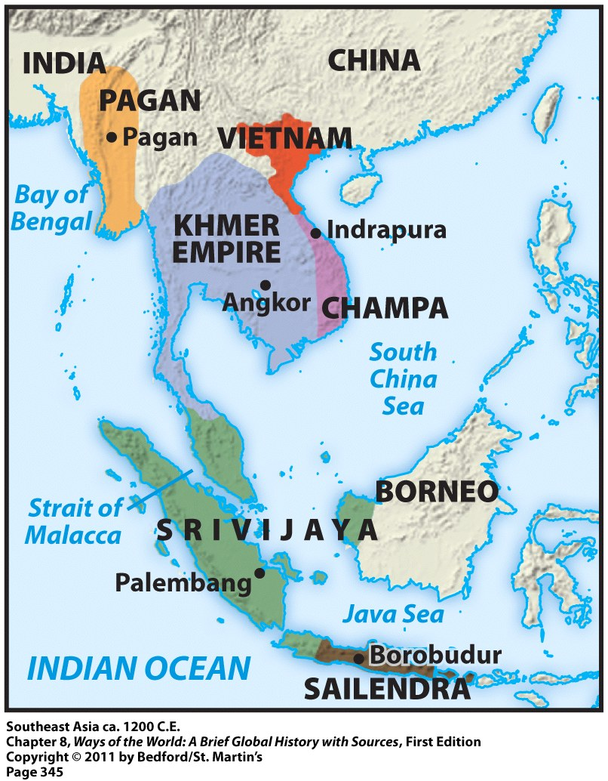
Southeast Asia & Srivijaya
Southeast Asia = between India and China
Its geography = allowed it to play an important role in Indian Ocean commerce
350 CE = Malay sailors opened an all-water sea route between India and China through the straits of Malacca
Result = more traders and travelers in the region
Result = ports along Malay Peninsula competed to attract these traders

Slide 13
Southeast Asia & Srivijaya
From this competition emerged the Malay kingdom of Srivijaya
Dominated this region of Indian Ocean commerce from 670 to 1025
Its advantages:
Big supply of gold
Access to in-demand spices
Placed taxes on passing ships

Slide 14
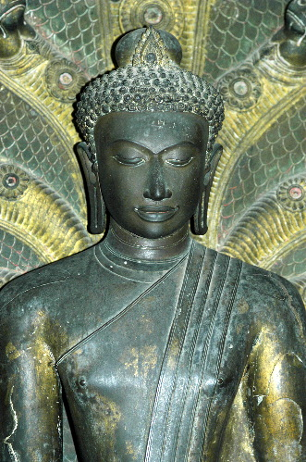
Srivijaya: Cultural Change
Influenced by Indian traders and adopted Buddhism
Rulers sponsored the creation of images of the Buddha and different bodhisattvas
Srivijaya = became a major center of Buddhist learning and culture

Slide 15
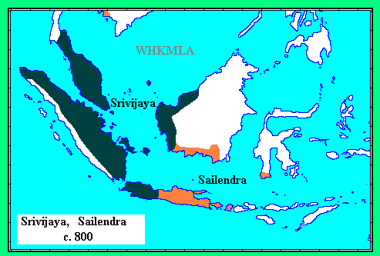
Sailendra Kindgom
Another kingdom in Southeast Asia influenced by Indian culture
Built huge Hindu temples and Buddhist monuments
Largest Buddhist monument anywhere in the world is located here = Borobudur

Slide 16
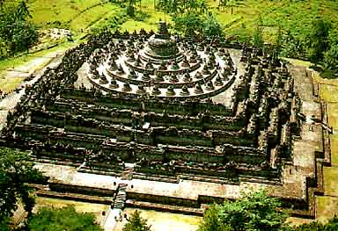
Borobudur
Mountain-shaped structure
10 levels
Elaborate carvings and illustrations
3-mile long walkway

Slide 17
East Africa & Swahili
Swahili civilization = set of commercial city-states stretching along the East African coast
Each city-state was politically independent with its own king
Big competition between each city-state
Sharp class distinctions in each city-state → big gap between the merchant elite class and the commoners

Slide 18
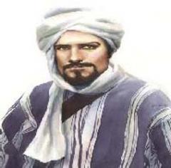
Swahili: Cultural Change
Arab, Indian, and Persian merchants = always welcome there
Swahili language = blend of African Bantu and Arabic
Swahili civilization = quickly became Islamic
Ibn Battuta = Arab scholar and merchant
Described these East African cities as Muslim societies

Slide 19
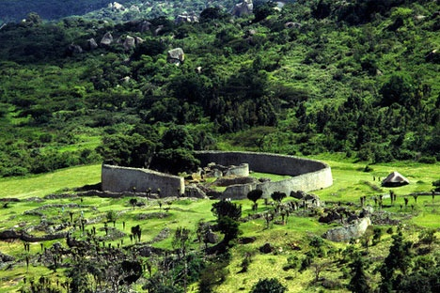
Coastal Cities = Intermediaries
Got valued goods from the interior of Africa and then sold them to others using the Indian Ocean trade network
This allowed regions in the interior of Africa to become wealthy even though they were not a part of the actual trade network
Example = state of Great Zimbabwe

