Slide 1
European Christendom
AP World History Notes
Chapter 7

Slide 2
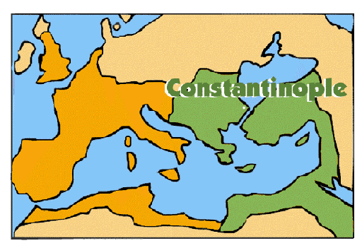
The Fall of the Roman Empire
395 CE = final division of Roman Empire into eastern and western halves
476 = end of the western Roman Empire
Eastern half remained intact = the Byzantine Empire (aka Byzantium)

Slide 3
Location of Constantinople very important: WHY????

Slide 4
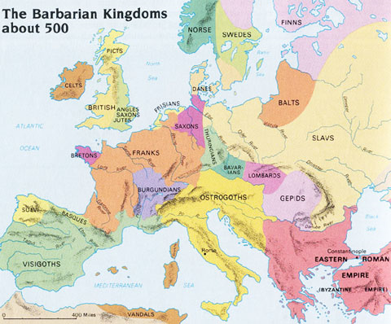
Western Europe After Rome
Roads in disrepair
Cities falling apart
Central government broke down
Long-distance trade stopped
People moved to rural areas
Christianity still dominant = Roman Catholicism

Slide 5
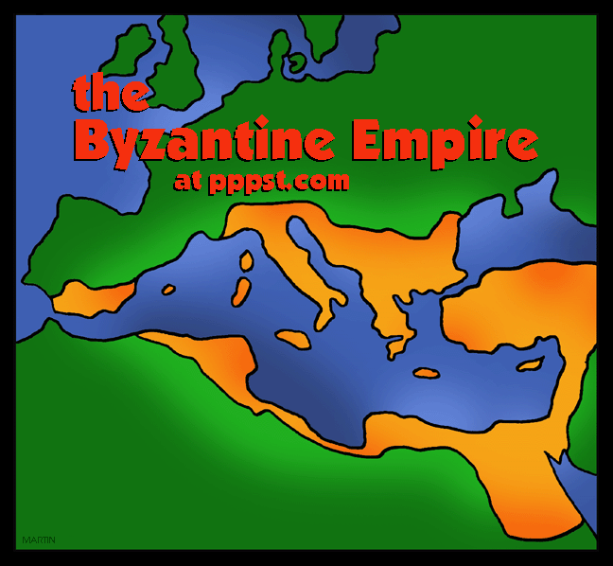
The Byzantine Empire
Unified and centralized government
Capital = Constantinople
Religion = Eastern Orthodox Christianity
Attempted to preserve some elements of the Roman Empire

Slide 6
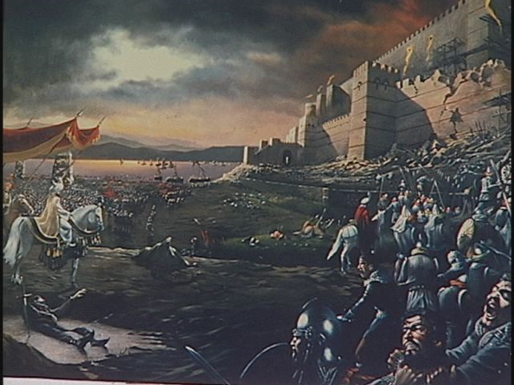
The Byzantine Empire
Advantages over Western Roman Empire:
Wealthier and more urbanized
More defensible capital; Constantinople was walled in
Shorter frontier to guard
Strong leaders and clever diplomacy

Slide 7
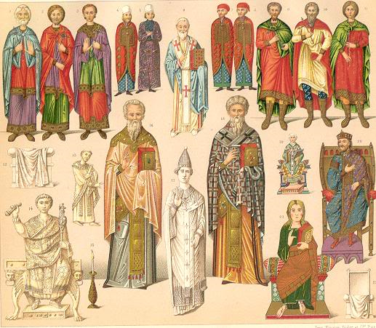
Preservation of the Roman Empire
Elements of the Roman Empire within Byzantium:
Roads
Taxation system
Military structures
Centralized administration
Laws and court system
Roman-style robes and sandals
But a lot changed as well

Slide 8
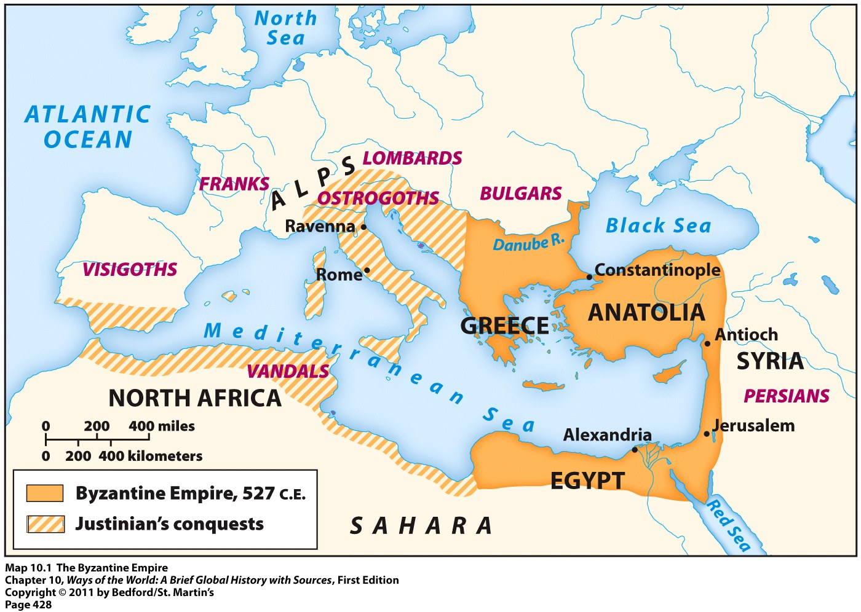
The Byzantine State
Never as large as the Roman Empire
Biggest during Justinian
Lost many territories due to Arab/Muslim expansion in the 7th century

Slide 9
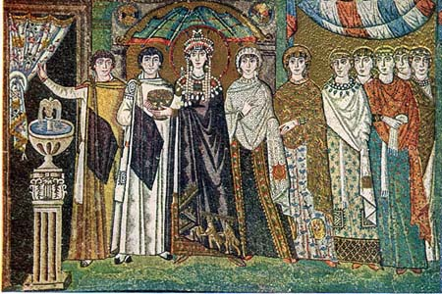
Political State of Byzantium
Centralized authority in Constantinople
Emperor viewed as “God’s earthly representative”
Imperial court filled with grandeur, wealth, and court ceremonies
Government focused on: collecting taxes, maintaining order, and suppressing revolts
Did not become heavily involved in the lives of most people
Empress Theodora (Justinian’s Wife)

Slide 10
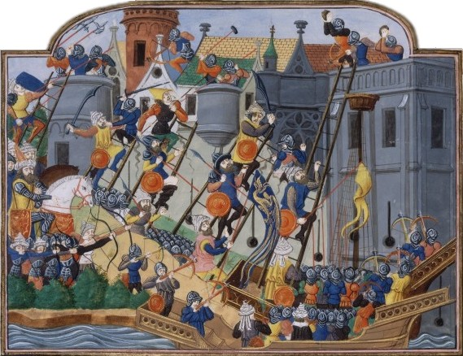
Political State of Byzantium
Began to face invasions after 1085 CE from:
Catholic Crusaders from Western Europe
Turkic Muslim invaders
Empire officially fell when Ottoman Turks conquered Constantinople in 1453

Slide 11
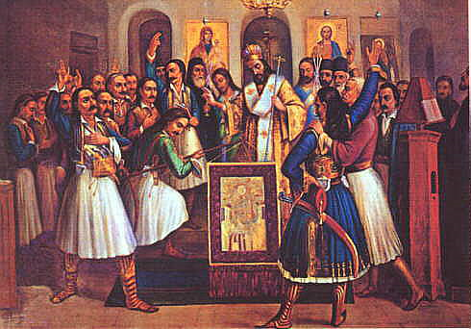
The Byzantine Church
Caesar = Political Leader
Pope (papacy) = Religious leader
Caesaropapism = Church and state were connected
Unlike in Western Europe → where the Roman Catholic Church was independent from political authorities
Emperor = assumed roles of head of state and head of the Church

Slide 12
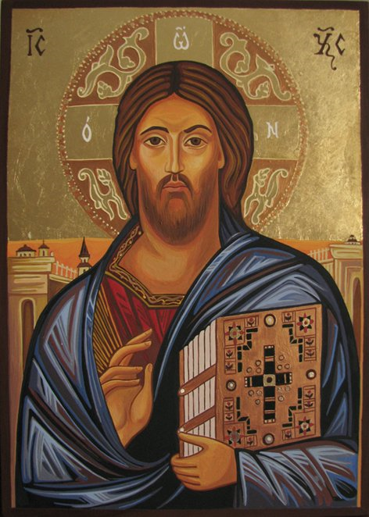
The Byzantine Church
Eastern Orthodox Christianity provided a cultural identity for people within the Byzantine Empire
Icons = religious paintings of Jesus, Mary, and other saints/holy figures

Slide 13
The Byzantine Church
Byzantine Empire
Greek
Priests grew long beards
Priests could get married
Rejected the authority of the Pope of Rome
Western Europe
Latin
Priests shaved
Priests = celibate
Accepted the Roman Pope as the sole authority for Christians everywhere
Eastern Orthodox
Roman Catholic

Slide 14
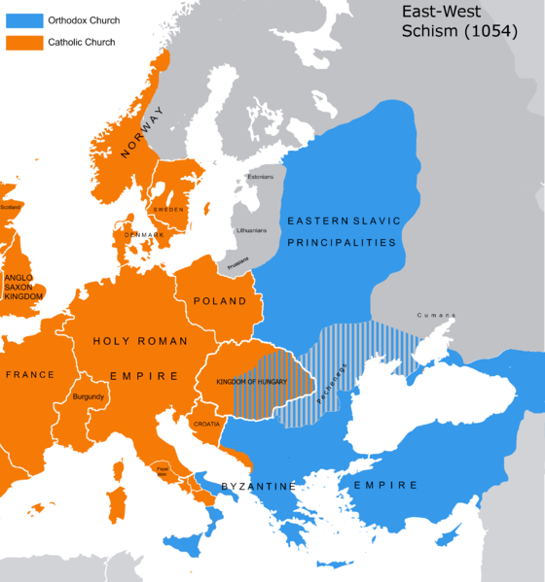
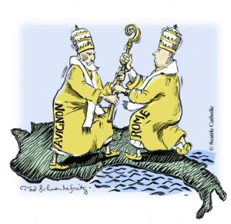
The Byzantine Church
Further separation came between the Eastern Orthodox Church and the Roman Catholic Church in 1054
Both Churches excommunicated each other
Declared that those in the opposing Christian tradition were not real Christians

Slide 15
Byzantium & the World
Central player in long-distance trade of Eurasia
Products made by Byzantine craftspeople in high demand
Jewelry
Gemstones
Silver and gold work
Linen, woolen, and silk textiles
Purple dyes

Slide 16
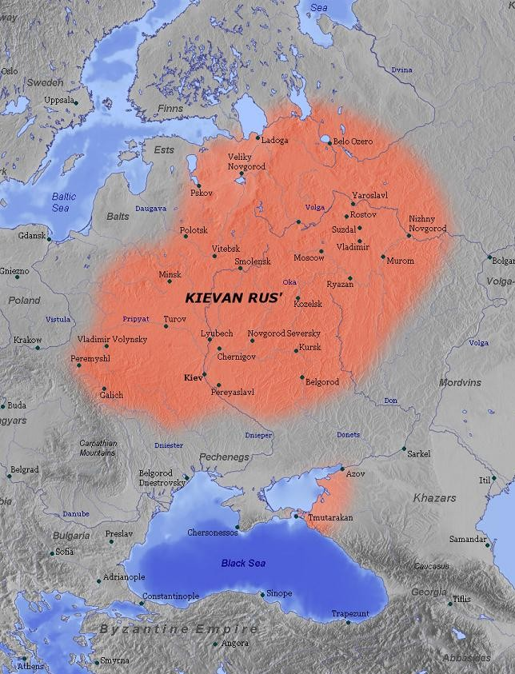
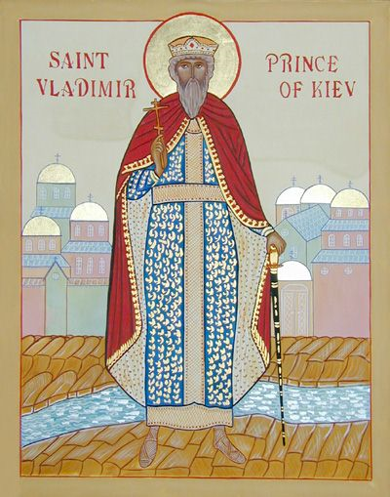
Conversion of Russia
Most significant expansion of Eastern Orthodox Christianity = to Kievan Rus
Modern-day Ukraine and western Russia
Major city = Kiev
Highly stratified society
Ruled by many different princes
Prince Vladimir = Prince of Kiev

Slide 17
Conversion of Russia
Prince Vladimir = wanted to bring a new faith to Rus that would unify the many diverse peoples of the region
He also wanted to link Rus into wider networks of communication and exchange in the world

Slide 18
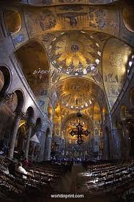
Conversion of Russia
Prince Vladimir was drawn to Eastern Orthodox Christianity because of:
The splendor and wealth of Constantinople
The beauty of Eastern Orthodox churches
As a result of this conversion he received:
A sister of the Byzantine emperor as a bride
Byzantine priests and advisors
Interior of St. Mark’s Basilica

Slide 19
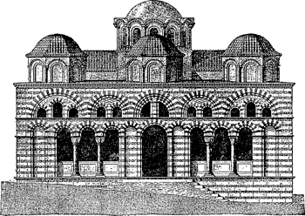
Conversion of Russia
Kievan Rus consequently adopted many Byzantine cultural elements:
Architectural styles
Cyrillic alphabet
Use of icons
Monastic tradition stressing prayer and service
Idea of imperial/state control of the Church

