Slide 1
China and Buddhism
AP World History Notes
Chapter 10
China from 500 to 1300

Slide 2
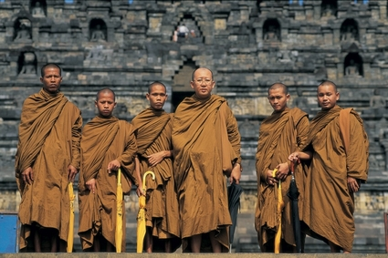
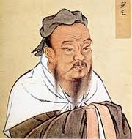
Initial Rejection of Buddhism
China did not take to Buddhism right away
Commitment to a secluded life for Buddhist monks and nuns contradicted Chinese belief in strong family values
Focus on individual salvation and enlightenment = selfish and against Confucianism
China was focused on “this world” with Confucianism and were wary of the concept of infinite time with Buddhism

Slide 3
Buddhism Takes Hold in China
When Han dynasty collapsed, people began to question Confucianism
Many turned to Buddhism instead and liked its emphasis on compassion, morality, and meditation
Rulers and elite families donated money to build Buddhist temples and monasteries

Slide 4
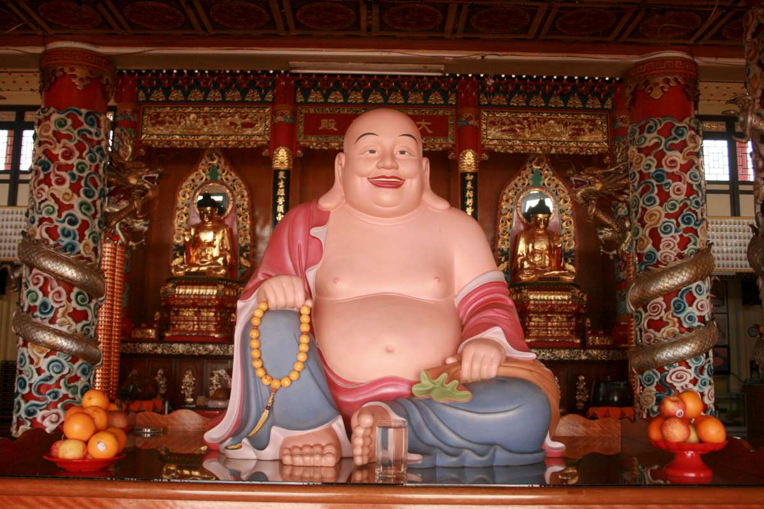
Buddhist Monasteries
Provided:
Accommodation for travelers
Refuge for people fleeing from China’s upheavals
Charity for the poor
Seeds for struggling farmers
Treatment and care for the sick
Education and books for children

Slide 5
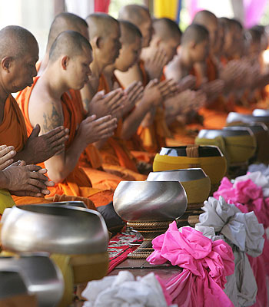
Buddhist Backlash
As Buddhism grew, some criticisms and resistance arose:
Resentment of its enormous wealth
Threat to imperial authority of China
Still seen as “foreign”
Withdrawal of monks from society = against family-based values of Confucianism

Slide 6
Chinese Imperial Decrees
Ordered monks and nuns to pay taxes
Thousands of Buddhist monasteries and temples were destroyed or turned to public use
State confiscated Buddhist land and property
Buddhists forbidden to use gold, silver, copper, iron, or gems to make their images

